Slide 1
Semi-Indexing JSON with SIMD
John Ky
(@newhoggy)

Slide 2
Overview
Inspiration
Refresher
Substance
Experience Report/Crowd Sourcing

Slide 3
Zurihac

Slide 4
Zurihac

Slide 5
Fast and Parallel State Machines by Gabriel Gonzalez

Slide 6
Inspiration to use SIMD
Fast DSV Parser
  https://github.com/haskell-works/hw-dsv
  https://haskell-works.github.io/
Fast JSON Parser
  https://github.com/haskell-works/hw-json
  https://github.com/haskell-works/hw-json-simd

Slide 7
What is a Semi-Index?

Slide 8
Balanced Parenthesis
[{"name": "Ergo Proxy", "published": 2006}, {"name": ...

Slide 9
Balanced Parenthesis
((( ) ( ) ( ) ( )) (( ) ...
[{"name": "Ergo Proxy", "published": 2006}, {"name": ...

Slide 10
Balanced Parenthesis
111 0 1 0 1 0 1 00 11 0 ...
((( ) ( ) ( ) ( )) (( ) ...
[{"name": "Ergo Proxy", "published": 2006}, {"name": ...

Slide 11
Position Index
111 0 1 0 1 0 1 00 11 0 ...
((( ) ( ) ( ) ( )) (( ) ...
[{"name": "Ergo Proxy", "published": 2006}, {"name": ...
1110000000100000000000001000000000000100000011000000 ...

Slide 12
Position Index
111 0 1 0 1 0 1 00 11 0 ...
((( ) ( ) ( ) ( )) (( ) ...
[{"name": "Ergo Proxy", "published": 2006}, {"name": ...
1110000000100000000000001000000000000100000011000000 ...
Interesting Bits Index

Slide 13
Position Index
Balanced Parenthesis Index
11101010100110 ...
111 0 1 0 1 0 1 00 11 0 ...
((( ) ( ) ( ) ( )) (( ) ...
[{"name": "Ergo Proxy", "published": 2006}, {"name": ...
1110000000100000000000001000000000000100000011000000 ...
Interesting Bits Index

Slide 14
Position Index
Balanced Parenthesis Index
11101010100110 ...
111 0 1 0 1 0 1 00 11 0 ...
((( ) ( ) ( ) ( )) (( ) ...
[{"name": "Ergo Proxy", "published": 2006}, {"name": ...
1110000000100000000000001000000000000100000011000000 ...
Interesting Bits Index

Slide 15
Building the Index

Slide 16
Building Blanked JSON
[{"name": "The \"Quote\"", ”quantity": 1.5, "available": true}]

Slide 17
Building Blanked JSON
[{"name": "The \"Quote\"", "quantity": 1.5, "available": true}]
[{( ) ( ) ( ) 100 ( ) t___}]

Slide 18
Building the Index
[{"name": "The \"Quote\"", ”quantity": 1.5, "available": true}]
[{( ) ( ) ( ) 100 ( ) t___}]

Slide 19
Building the Index
[{"name": "The \"Quote\"", ”quantity": 1.5, "available": true}]
[{( ) ( ) ( ) 100 ( ) t___}]
111 0 1 0 1 0 1 0 1 0 1 000

Slide 20
Building Blanked JSON
[{"name": "The \"Quote\"", ”quantity": 1.5, "available": true}]
[{( ) ( ) ( ) 100 ( ) t___}]
111 0 1 0 1 0 1 0 1 0 1 000
111000000010000000000000000100000000000100001000000000000100000

Slide 21
Benchmarking:
Index Creation (Original)
$ ls -hl sample.json
-rw-r--r-- 1 jky staff 25M 17 Jan 23:03 sample.json
$ time hw-json create-index -b standard -m original -i sample.json
0.84s user 0.14s system 199% cpu 0.488 total

Slide 22
Primer on State Machines

Slide 23
Primer on State Machines
D := (Q, Σ, q₀, δ, F)

Slide 24
Primer on State Machines
D := (Q, Σ, q₀, δ, F)
D: Finite State Machine

Slide 25
Primer on State Machines
D := (Q, Σ, q₀, δ, F)
D: Finite State Machine
Q: Set of States

Slide 26
Primer on State Machines
D := (Q, Σ, q₀, δ, F)
D: Finite State Machine
Q: Set of States
Σ: Fixed Alphabet

Slide 27
Primer on State Machines
D := (Q, Σ, q₀, δ, F)
D: Finite State Machine
Q: Set of States
Σ: Fixed Alphabet
q₀: Initial state

Slide 28
Primer on State Machines
D := (Q, Σ, q₀, δ, F)
D: Finite State Machine
Q: Set of States
Σ: Fixed Alphabet
q₀: Initial state
δ: Transition Function
Q × Σ → Q

Slide 29
Primer on State Machines
D := (Q, Σ, q₀, δ, F)
D: Finite State Machine
Q: Set of States
Σ: Fixed Alphabet
q₀: Initial state
δ: Transition Function
Q × Σ → Q
F: Final set of States
F ⊆ Q

Slide 30
State Machine Example: Multiline Comments
D := (Q, Σ, q₀, δ, F)

Slide 31
State Machine Example: Multiline Comments
a
b
c
d
D := (Q, Σ, q₀, δ, F)

Slide 32
Simple State Machine Example
a
b
c
d
D := (Q, Σ, q₀, δ, F)
Σ:={/, *, x}

Slide 33
Simple State Machine Example
a
b
c
d
D := (Q, Σ, q₀, δ, F)
Σ:={/, *, x}

Slide 34
Simple State Machine Example
/
*
a
b
*
c
d
x
x
*x
*
/
/x
/
D := (Q, Σ, q₀, δ, F)
Σ:={/, *, x}

Slide 35
Simple State Machine Example
/
*
a
b
*
c
d
x
x
*x
*
/
/x
/
D := (Q, Σ, q₀, δ, F)
Σ:={/, *, x}

Slide 36
Simple State Machine Example
/
*
T
a
b
*
c
d
a
x
x
*x
*
b
/
/x
/
c
d
D := (Q, Σ, q₀, δ, F)
Σ:={/, *, x}

Slide 37
Simple State Machine Example
/
*
T
/
*
x
a
b
*
c
d
a
x
x
*x
*
b
/
/x
/
c
d
D := (Q, Σ, q₀, δ, F)
Σ:={/, *, x}

Slide 38
Simple State Machine Example
/
*
T
/
*
x
a
b
*
c
d
a
b
a
a
x
x
*x
*
b
b
c
a
/
/x
/
c
c
d
c
d
a
d
c
D := (Q, Σ, q₀, δ, F)
Σ:={/, *, x}

Slide 39
Simple State Machine Example
/
*
T
/
*
x
a
b
*
c
d
a
b
a
a
x
x
*x
*
b
b
c
a
/
/x
/
c
c
d
c
d
a
d
c

Slide 40
Simple State Machine Example
/
*
T
/
*
a
a
b
*
c
d
a
b
a
a
x
x
*x
*
b
b
c
a
/
/x
/
c
c
d
c
state = a
foreach (c in input)
state = T[c][state]
return F.contains(state)
d
a
d
c

Slide 41
Simple State Machine Example
/
*
T
/
*
a
a
b
*
c
d
a
b
a
a
x
x
*x
*
b
b
c
a
/
/x
/
c
c
d
c
state = a
foreach (c in input)
state = T[c][state]
return F.contains(state)
d
a
d
c

Slide 42
Simple State Machine Example
/
*
T
/
*
a
a
b
*
c
d
a
b
a
a
x
x
*x
*
b
b
c
a
/
/x
/
c
c
d
c
state = a
foreach (c in input)
state = T[c][state]
return F.contains(state)
d
a
d
c

Slide 43
Simple State Machine Example
/
*
T
/
*
a
a
b
*
c
d
a
b
a
a
x
x
*x
*
b
b
c
a
/
/x
/
c
c
d
c
state = a
foreach (c in input)
state = T[c][state]
return F.contains(state)
d
a
d
c

Slide 44
Simple State Machine Example
/
*
T
/
*
a
a
b
*
c
d
a
b
a
a
x
x
*x
*
b
b
c
a
/
/x
/
c
c
d
c
step :: State -> Input -> State
d
a
d
c

Slide 45
Simple State Machine Example
/
*
T
/
*
a
a
b
*
c
d
a
b
a
a
x
x
*x
*
b
b
c
a
/
/x
/
c
c
d
c
step :: State -> Input -> State
d
a
d
c

Slide 46
Simple State Machine Example
/
*
T
/
*
a
a
b
*
c
d
a
b
a
a
x
x
*x
*
b
b
c
a
/
/x
/
c
c
d
c
step :: State -> Input -> State
run :: [Input] -> State -> State
run = foldl step initialState
d
a
d
c

Slide 47
Simple State Machine Example
/
*
T
/
*
a
a
b
*
c
d
a
b
a
a
x
x
*x
*
b
b
c
a
/
/x
/
c
c
d
c
step :: State -> Input -> State
run :: [Input] -> State -> State
run = foldl step initialState
accept :: State -> Bool
d
a
d
c

Slide 48
JSON Grammar

Slide 49
JSON Grammar
Source: http://json.org/

Slide 50
JSON Grammar
Source: http://json.org/

Slide 51
JSON Grammar
Input
Source: http://json.org/

Slide 52
JSON Grammar
Input
State-ish
Source: http://json.org/

Slide 53
JSON Grammar
..."value": -123.05e+20, ”descr...
BP: ...1010...
IB: ...1000000001000000000000010000...
Source: http://json.org/

Slide 54
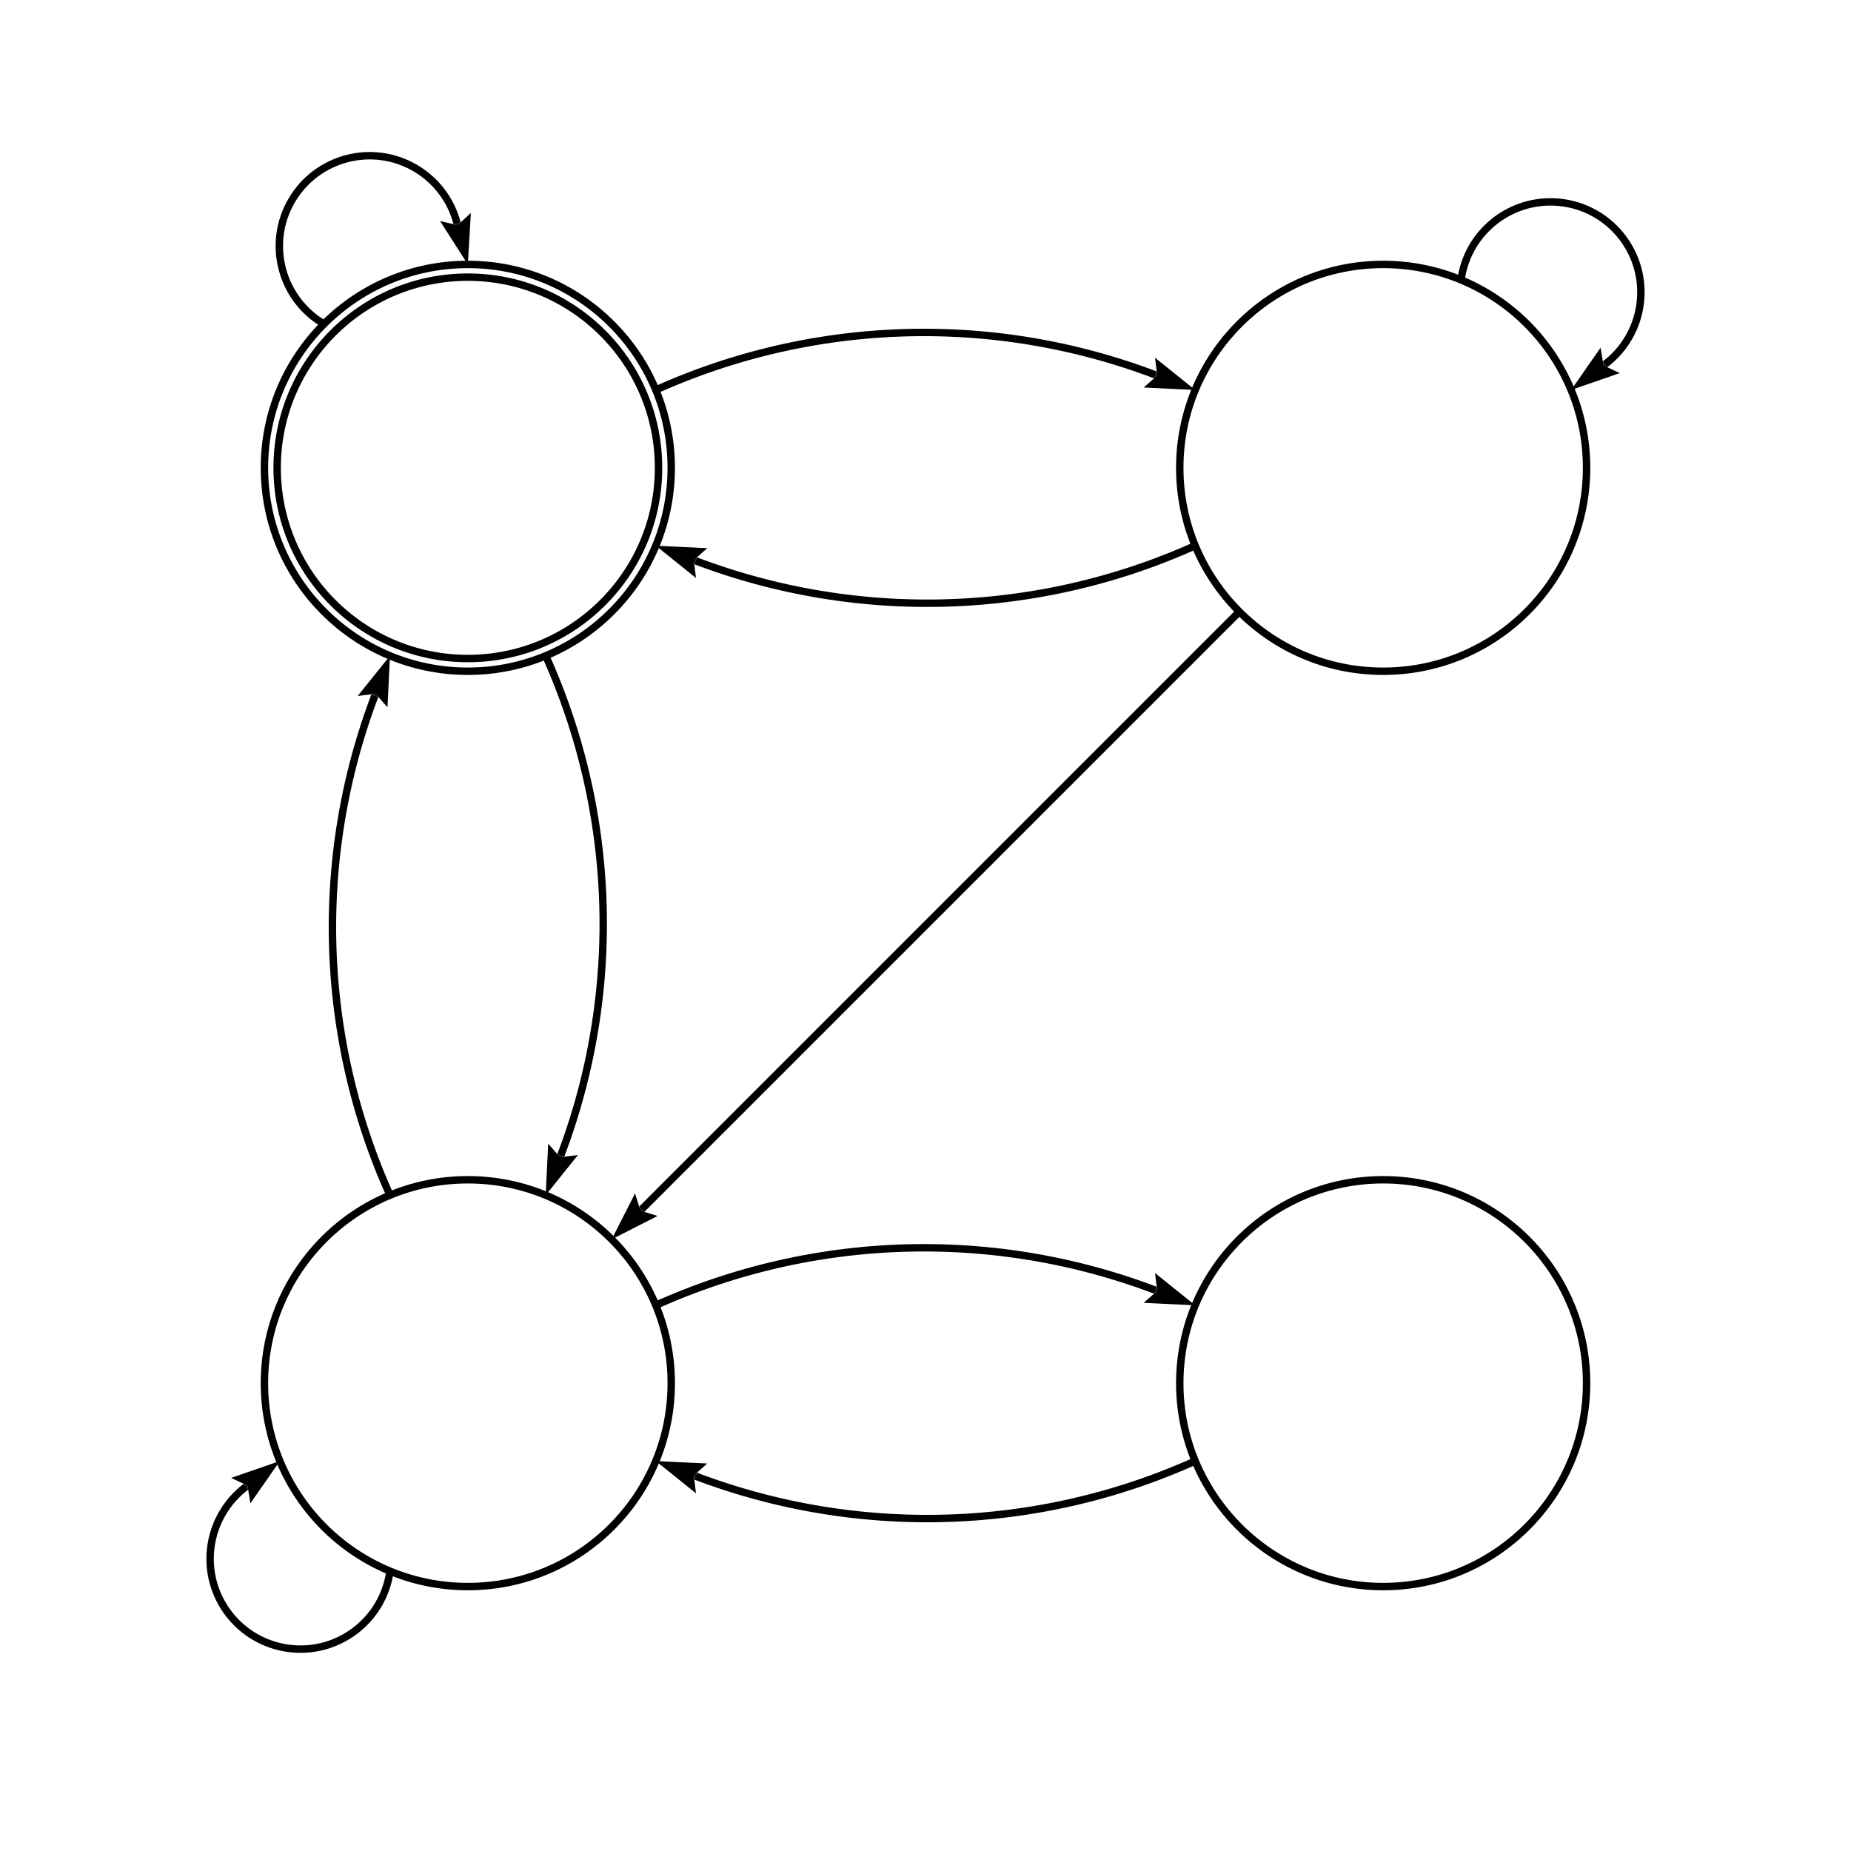
Simplified State Machine for JSON Parsing
*
A-Za-z0-9+-
A-Za-z0-9+-
JSON
Value
*
"
"
"
\
String
Escaped
*
*

Slide 55
Simplified State Machine for JSON Parsing
TEXT: [{"fst": "a\"1", "snd": 123}]
BP:
IB:
*
A-Za-z0-9+-
A-Za-z0-9+-
JSON
Value
*
"
"
"
String
\
Escaped
*
*

Slide 56
Simplified State Machine
for JSON Parsing
TEXT: [{"fst": ”a\"1", ”snd": 123}]
BP: (
IB: 1
*
A-Za-z0-9+-
A-Za-z0-9+-
JSON
Value
*
"
"
"
String
\
Escaped
*
*

Slide 57
Simplified State Machine
for JSON Parsing
TEXT: [{"fst": ”a\"1", ”snd": 123}]
BP: (
IB: 1
*
A-Za-z0-9+-
A-Za-z0-9+-
JSON
Value
*
"
"
"
?
String
\
Escaped
*
*

Slide 58
Simplified State Machine
for JSON Parsing
TEXT: [{"fst": ”a\"1", ”snd": 123}]
BP: (
IB: 1
*
A-Za-z0-9+-
A-Za-z0-9+-
JSON
Value
*
"
"
"
bp :: State -> Byte -> BP
ib :: State -> Byte -> IB
String
\
Escaped
*
*

Slide 59
Simplified State Machine
for JSON Parsing
TEXT: [{"fst": ”a\"1", ”snd": 123}]
BP: (
IB: 1
*
A-Za-z0-9+-
A-Za-z0-9+-
JSON
Value
*
"
"
"
bp :: State -> Byte -> BP
ib :: State -> Byte -> IB
≅
bpip :: State -> Byte -> BPIP
String
\
Escaped
*
*

Slide 60
Simplified State Machine for JSON Parsing
TEXT: [{"fst": "a\"1", "snd": 123}]
BP: ((
IB: 11
*
A-Za-z0-9+-
A-Za-z0-9+-
JSON
Value
*
"
"
"
String
\
Escaped
*
*

Slide 61
Simplified State Machine for JSON Parsing
TEXT: [{"fst": ”a\"1", "snd": 123}]
BP: ((()
IB: 111
*
A-Za-z0-9+-
A-Za-z0-9+-
JSON
Value
*
"
"
"
String
\
Escaped
*
*

Slide 62
Simplified State Machine for JSON Parsing
TEXT: [{"fst": "a\"1", "snd": 123}]
BP: ((()
IB: 1110
*
A-Za-z0-9+-
A-Za-z0-9+-
JSON
Value
*
"
"
"
String
\
Escaped
*
*

Slide 63
Simplified State Machine for JSON Parsing
TEXT: [{"fst": "a\"1", "snd": 123}]
BP: ((()
IB: 11100
*
A-Za-z0-9+-
A-Za-z0-9+-
JSON
Value
*
"
"
"
String
\
Escaped
*
*

Slide 64
Simplified State Machine for JSON Parsing
TEXT: [{"fst": "a\"1", "snd": 123}]
BP: ((()
IB: 111000
*
A-Za-z0-9+-
A-Za-z0-9+-
JSON
Value
*
"
"
"
String
\
Escaped
*
*

Slide 65
Simplified State Machine for JSON Parsing
TEXT: [{"fst": "a\"1", "snd": 123}]
BP: ((()
IB: 1110000
*
A-Za-z0-9+-
A-Za-z0-9+-
JSON
Value
*
"
"
"
String
\
Escaped
*
*

Slide 66
Simplified State Machine for JSON Parsing
TEXT: [{"fst": "a\"1", "snd": 123}]
BP: ((()
IB: 111000000
*
A-Za-z0-9+-
A-Za-z0-9+-
JSON
Value
*
"
"
"
String
\
Escaped
*
*

Slide 67
Simplified State Machine for JSON Parsing
TEXT: [{"fst": "a\"1", "snd": 123}]
BP: ((()()
IB: 1110000001
*
A-Za-z0-9+-
A-Za-z0-9+-
JSON
Value
*
"
"
"
String
\
Escaped
*
*

Slide 68
Simplified State Machine for JSON Parsing
TEXT: [{"fst": "a\"1", "snd": 123}]
BP: ((()()
IB: 11100000010
*
A-Za-z0-9+-
A-Za-z0-9+-
JSON
Value
*
"
"
"
String
\
Escaped
*
*

Slide 69
Simplified State Machine for JSON Parsing
TEXT: [{"fst": "a\"1", "snd": 1234}
BP: ((()()
IB: 111000000100
*
A-Za-z0-9+-
A-Za-z0-9+-
JSON
Value
*
"
"
"
String
\
Escaped
*
*

Slide 70
Simplified State Machine for JSON Parsing
TEXT: [{"fst": "a\"1", "snd": 123}]
BP: ((()()
IB: 1110000001000
*
A-Za-z0-9+-
A-Za-z0-9+-
JSON
Value
*
"
"
"
String
\
Escaped
Note the 0
*
*

Slide 71
Simplified State Machine for JSON Parsing
TEXT: [{"fst": "a\"1", "snd": 123}]
BP: ((()()
IB: 11100000010000
*
A-Za-z0-9+-
A-Za-z0-9+-
JSON
Value
*
"
"
"
String
\
Escaped
*
*

Slide 72
Simplified State Machine for JSON Parsing
TEXT: [{"fst": "a\"1", "snd": 123}]
BP: ((()()
IB: 111000000100000
*
A-Za-z0-9+-
A-Za-z0-9+-
JSON
Value
*
"
"
"
String
\
Escaped
*
*

Slide 73
Simplified State Machine for JSON Parsing
TEXT: [{"fst": "a\"1", "snd": 123}]
BP: ((()()
IB: 1110000001000000
*
A-Za-z0-9+-
A-Za-z0-9+-
JSON
Value
*
"
"
"
String
\
Escaped
*
*

Slide 74
Simplified State Machine for JSON Parsing
TEXT: [{"fst": "a\"1", "snd": 123}]
BP: ((()()
IB: 11100000010000000
*
A-Za-z0-9+-
A-Za-z0-9+-
JSON
Value
*
"
"
"
String
\
Escaped
*
*

Slide 75
Simplified State Machine for JSON Parsing
TEXT: [{"fst": "a\"1", "snd": 123}]
BP: ((()()()
IB: 111000000100000001
*
A-Za-z0-9+-
A-Za-z0-9+-
JSON
Value
*
"
"
"
String
\
Escaped
*
*

Slide 76
Simplified State Machine for JSON Parsing
TEXT: [{"fst": "a\"1", "snd": 123}]
BP: ((()()()
IB: 1110000001000000010
*
A-Za-z0-9+-
A-Za-z0-9+-
JSON
Value
*
"
"
"
String
\
Escaped
*
*

Slide 77
Simplified State Machine for JSON Parsing
TEXT: [{"fst": "a\"1", "snd": 123}]
BP: ((()()()
IB: 11100000010000000100
*
A-Za-z0-9+-
A-Za-z0-9+-
JSON
Value
*
"
"
"
String
\
Escaped
*
*

Slide 78
Simplified State Machine for JSON Parsing
TEXT: [{"fst": "a\"1", "snd": 123}]
BP: ((()()()
IB: 111000000100000001000
*
A-Za-z0-9+-
A-Za-z0-9+-
JSON
Value
*
"
"
"
String
\
Escaped
*
*

Slide 79
Simplified State Machine for JSON Parsing
TEXT: [{"fst": "a\"1", "snd": 123}]
BP: ((()()()
IB: 1110000001000000010000
*
A-Za-z0-9+-
A-Za-z0-9+-
JSON
Value
*
"
"
"
String
\
Escaped
*
*

Slide 80
Simplified State Machine for JSON Parsing
TEXT: [{"fst": "a\"1", "snd": 123}]
BP: ((()()()
IB: 11100000010000000100000
*
A-Za-z0-9+-
A-Za-z0-9+-
JSON
Value
*
"
"
"
String
\
Escaped
*
*

Slide 81
Simplified State Machine for JSON Parsing
TEXT: [{"fst": "a\"1", "snd": 123}]
BP: ((()()()
IB: 111000000100000001000000
*
A-Za-z0-9+-
A-Za-z0-9+-
JSON
Value
*
"
"
"
String
\
Escaped
*
*

Slide 82
Simplified State Machine for JSON Parsing
TEXT: [{"fst": "a\"1", "snd": 123}]
BP: ((()()()()
IB: 1110000001000000010000001
*
A-Za-z0-9+-
A-Za-z0-9+-
JSON
Value
*
"
"
"
String
\
Escaped
*
*

Slide 83
Simplified State Machine for JSON Parsing
TEXT: [{"fst": "a\"1", "snd": 123}]
BP: ((()()()()
IB: 11100000010000000100000010
*
A-Za-z0-9+-
A-Za-z0-9+-
JSON
Value
*
"
"
"
String
\
Escaped
Note the 0
*
*

Slide 84
Simplified State Machine for JSON Parsing
TEXT: [{"fst": "a\"1", "snd": 123}]
BP: ((()()()()
IB: 111000000100000001000000100
*
A-Za-z0-9+-
A-Za-z0-9+-
JSON
Value
*
"
"
"
String
\
Escaped
*
*

Slide 85
Simplified State Machine for JSON Parsing
TEXT: [{"fst": "a\"1", "snd": 123}]
BP: ((()()()())
IB: 1110000001000000010000001000
*
A-Za-z0-9+-
A-Za-z0-9+-
JSON
Value
*
"
"
"
String
\
Escaped
*
*

Slide 86
Simplified State Machine for JSON Parsing
TEXT: [{"fst": "a\"1", "snd": 123}]
BP: ((()()()()))
IB: 11100000010000000100000010000
*
A-Za-z0-9+-
A-Za-z0-9+-
JSON
Value
*
"
"
"
String
\
Escaped
*
*

Slide 87
Simplified State Machine for JSON Parsing
TEXT: [{"fst": "a\"1", "snd": 123}]
BP: 111010101000
IB: 11100000010000000100000010000
*
A-Za-z0-9+-
A-Za-z0-9+-
JSON
Value
*
"
"
"
String
\
Escaped
*
*

Slide 88
Simplified State Machine for JSON Parsing
TEXT: [{"fst": "a\"1", "snd": 123}]
BP: 111010101000
IB: 11100000010000000100000010000
*
A-Za-z0-9+-
A-Za-z0-9+-
JSON
Value
*
"
"
"
String
\
Escaped
*
*

Slide 89
Benchmarking:
Index Creation (Functions)
$ ls -hl sample.json
-rw-r--r-- 1 jky staff 25M 17 Jan 23:03 sample.json
$ time hw-json create-index -b standard -m original -i sample.json
0.84s user 0.14s system 199% cpu 0.488 total

Slide 90
Benchmarking:
Index Creation (Functions)
$ ls -hl sample.json
-rw-r--r-- 1 jky staff 25M 17 Jan 23:03 sample.json
$ time hw-json create-index -b standard -m original -i sample.json
0.84s user 0.14s system 199% cpu 0.488 total
$ time hw-json create-index -b standard -m alternate -i sample.json
2.18s user 0.37s system 223% cpu 1.142 total

Slide 91
Benchmarking:
Index Creation (Tables)
$ ls -hl sample.json
-rw-r--r-- 1 jky staff 25M 17 Jan 23:03 sample.json
$ time hw-json create-index -b standard -m original -i sample.json
0.84s user 0.14s system 199% cpu 0.488 total
$ time hw-json create-index -b standard -m alternate -i sample.json
2.18s user 0.37s system 223% cpu 1.142 total
$ time hw-json create-index -b standard -m tabular -i sample.json
0.73s user 0.08s system 134% cpu 0.604 total

Slide 92
The problem with Finite State Machines
is they are inherently Serial
due to Data Dependency
Each step of the Finite State Machine
relies on the current state being known,
which can only be the case
if all previous transitions have completed

Slide 93
Parallel Finite State Machines differ in that
each Parallel Transition finds the
all possible next states
from all possible initial states
There is no current state
Parallel Transitions can be composed
without all prior transitions having been computed

Slide 94
Parallel Transitions
*
A-Za-z0-9+-
*
A-Za-z0-9+-
*
A-Za-z0-9+-
*
A-Za-z0-9+-
A-Za-z0-9+-
A-Za-z0-9+-
A-Za-z0-9+-
A-Za-z0-9+-
JSON
Value
JSON
Value
JSON
Value
JSON
Value
*
*
*
*
"
"
"
"
"
"
"
"
"
"
"
"
\
\
\
\
String
Escaped
String
Escaped
String
Escaped
String
Escaped
*
*
*
*
*
*
*
*

Slide 95
Parallel Transitions
*
A-Za-z0-9+-
*
A-Za-z0-9+-
*
A-Za-z0-9+-
*
A-Za-z0-9+-
A-Za-z0-9+-
A-Za-z0-9+-
A-Za-z0-9+-
A-Za-z0-9+-
JSON
Value
JSON
Value
JSON
Value
JSON
Value
*
*
*
*
"
"
"
"
"
"
"
"
"
"
"
"
\
\
\
\
String
Escaped
String
Escaped
String
Escaped
String
Escaped
*
*
*
*
*
*
*
*
\

Slide 96
Parallel Transitions
*
A-Za-z0-9+-
*
A-Za-z0-9+-
*
A-Za-z0-9+-
*
A-Za-z0-9+-
A-Za-z0-9+-
A-Za-z0-9+-
A-Za-z0-9+-
A-Za-z0-9+-
JSON
Value
JSON
Value
JSON
Value
JSON
Value
*
*
*
*
"
"
"
"
"
"
"
"
"
"
"
"
\
\
\
\
String
Escaped
String
Escaped
String
Escaped
String
Escaped
*
*
*
*
*
*
*
A-Za-z0-9+-
*
\

Slide 97
Parallel Transitions
*
A-Za-z0-9+-
*
A-Za-z0-9+-
*
A-Za-z0-9+-
*
A-Za-z0-9+-
A-Za-z0-9+-
A-Za-z0-9+-
A-Za-z0-9+-
A-Za-z0-9+-
JSON
Value
JSON
Value
JSON
Value
JSON
Value
*
*
*
*
"
"
"
"
"
"
"
"
"
"
"
"
\
\
\
\
String
Escaped
String
Escaped
String
Escaped
String
Escaped
*
*
*
*
*
*
"
*
A-Za-z0-9+-
*
\

Slide 98
Parallel Transitions
*
A-Za-z0-9+-
*
A-Za-z0-9+-
*
A-Za-z0-9+-
*
A-Za-z0-9+-
A-Za-z0-9+-
A-Za-z0-9+-
A-Za-z0-9+-
A-Za-z0-9+-
JSON
Value
JSON
Value
JSON
Value
JSON
Value
*
*
*
*
"
"
"
"
"
"
"
"
"
"
"
"
\
\
\
\
String
Escaped
String
Escaped
String
Escaped
String
Escaped
*
*
*
*
*
*
*
"
*
A-Za-z0-9+-
*
\

Slide 99
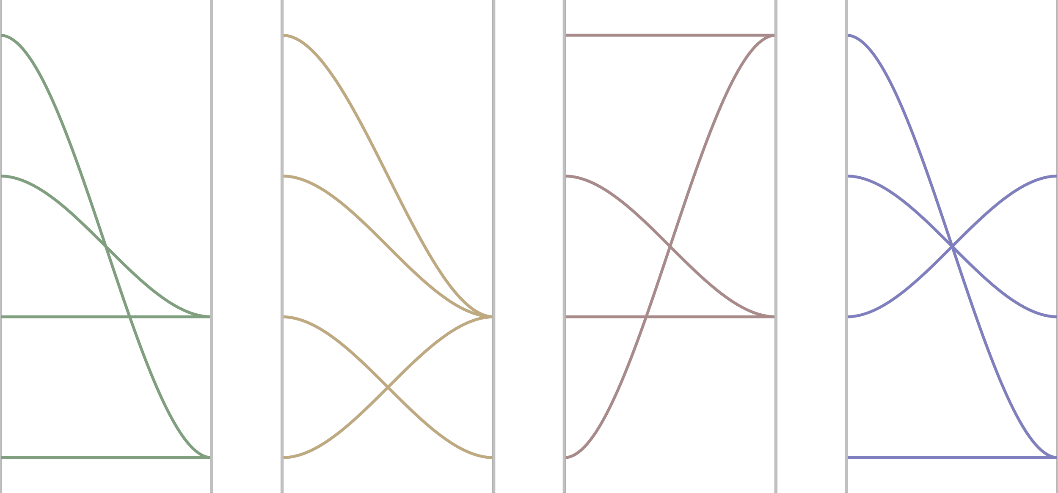
Parallel Transitions
*
A-Za-z0-9+-
*
A-Za-z0-9+-
*
A-Za-z0-9+-
*
A-Za-z0-9+-
A-Za-z0-9+-
A-Za-z0-9+-
A-Za-z0-9+-
A-Za-z0-9+-
JSON
Value
JSON
Value
JSON
Value
JSON
Value
*
*
*
*
"
"
"
"
"
"
"
"
"
"
"
"
\
\
\
\
String
Escaped
String
Escaped
String
Escaped
String
Escaped
*
*
*
*
*
*
*
"
*
A-Za-z0-9+-
*
\
Value
Escape
String
Json

Slide 100
Parallel Transitions
*
A-Za-z0-9+-
*
A-Za-z0-9+-
*
A-Za-z0-9+-
*
A-Za-z0-9+-
A-Za-z0-9+-
A-Za-z0-9+-
A-Za-z0-9+-
A-Za-z0-9+-
JSON
Value
JSON
Value
JSON
Value
JSON
Value
*
*
*
*
"
"
"
"
"
"
"
"
"
"
"
"
\
\
\
\
String
Escaped
String
Escaped
String
Escaped
String
Escaped
*
*
*
*
*
*
*
"
*
A-Za-z0-9+-
*
\
Value
3
Escape
2
String
1
Json
0

Slide 101
Parallel Transitions
*
A-Za-z0-9+-
*
A-Za-z0-9+-
*
A-Za-z0-9+-
*
A-Za-z0-9+-
A-Za-z0-9+-
A-Za-z0-9+-
A-Za-z0-9+-
A-Za-z0-9+-
JSON
Value
JSON
Value
JSON
Value
JSON
Value
*
*
*
*
"
"
"
"
"
"
"
"
"
"
"
"
\
\
\
\
String
Escaped
String
Escaped
String
Escaped
String
Escaped
*
*
*
*
*
*
*
"
*
A-Za-z0-9+-
*
\
Value
3
Escape
2
String
1
Json
0
0x00010100

Slide 102
Parallel Transitions
*
A-Za-z0-9+-
*
A-Za-z0-9+-
*
A-Za-z0-9+-
*
A-Za-z0-9+-
A-Za-z0-9+-
A-Za-z0-9+-
A-Za-z0-9+-
A-Za-z0-9+-
JSON
Value
JSON
Value
JSON
Value
JSON
Value
*
*
*
*
"
"
"
"
"
"
"
"
"
"
"
"
\
\
\
\
String
Escaped
String
Escaped
String
Escaped
String
Escaped
*
*
*
*
*
*
*
"
*
A-Za-z0-9+-
*
\
Value
3
Escape
2
String
1
Json
0
0x00010100

Slide 103
Parallel Transitions
*
A-Za-z0-9+-
*
A-Za-z0-9+-
*
A-Za-z0-9+-
*
A-Za-z0-9+-
A-Za-z0-9+-
A-Za-z0-9+-
A-Za-z0-9+-
A-Za-z0-9+-
JSON
Value
JSON
Value
JSON
Value
JSON
Value
*
*
*
*
"
"
"
"
"
"
"
"
"
"
"
"
\
\
\
\
String
Escaped
String
Escaped
String
Escaped
String
Escaped
*
*
*
*
*
*
*
"
*
A-Za-z0-9+-
*
\
Value
3
Escape
2
String
1
Json
0
0x00010100
0x01010001
0x03010103
0x00010200

Slide 104
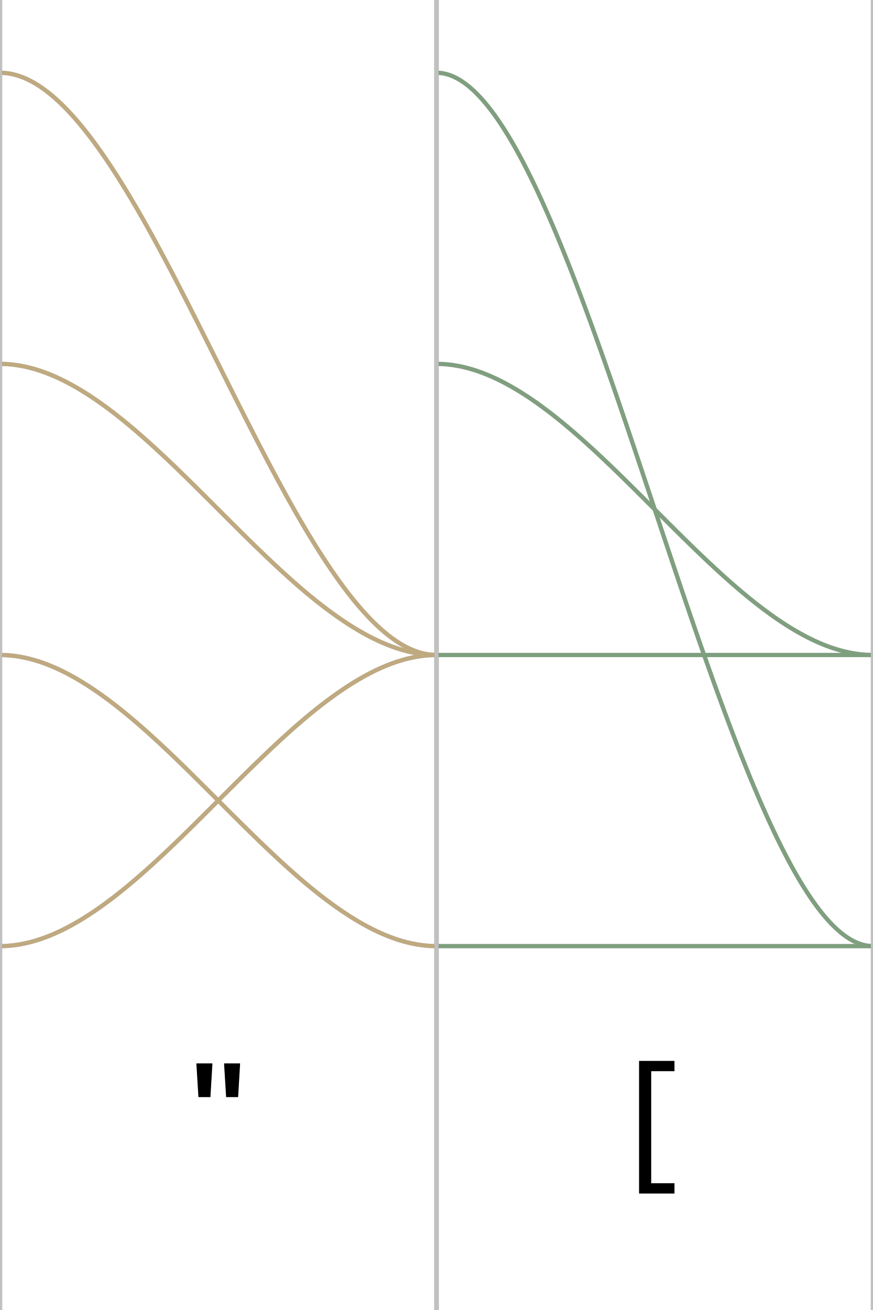
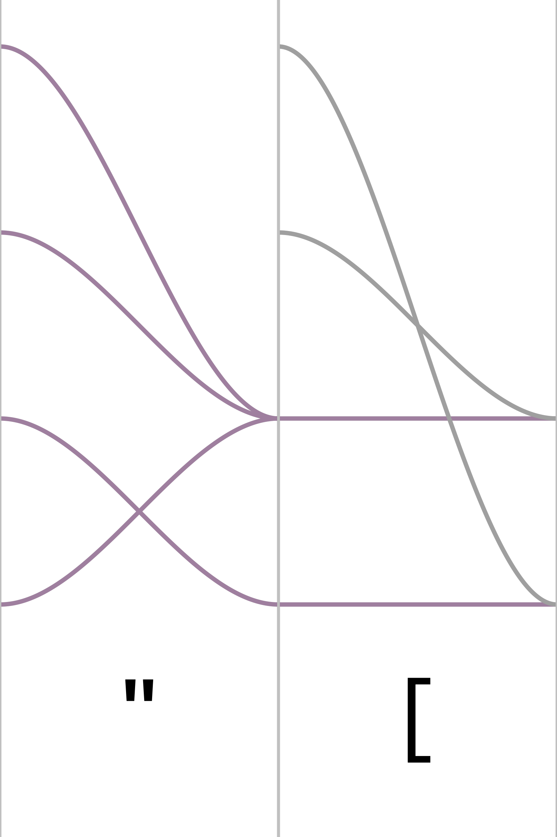
0x01010001
0x00010100
0x00010100

Slide 105
0x01010001
0x00010100
0x01010001
_mm_shuffle_epi8(0x00010100, 0x01010001) = 0x01010001

Slide 106
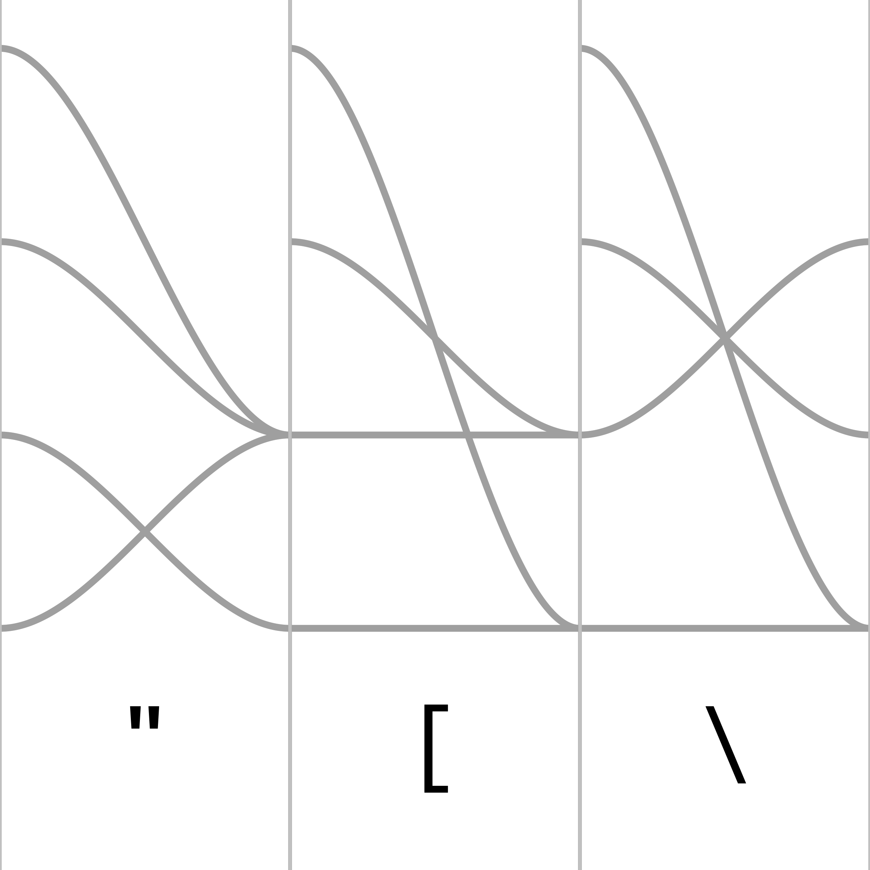
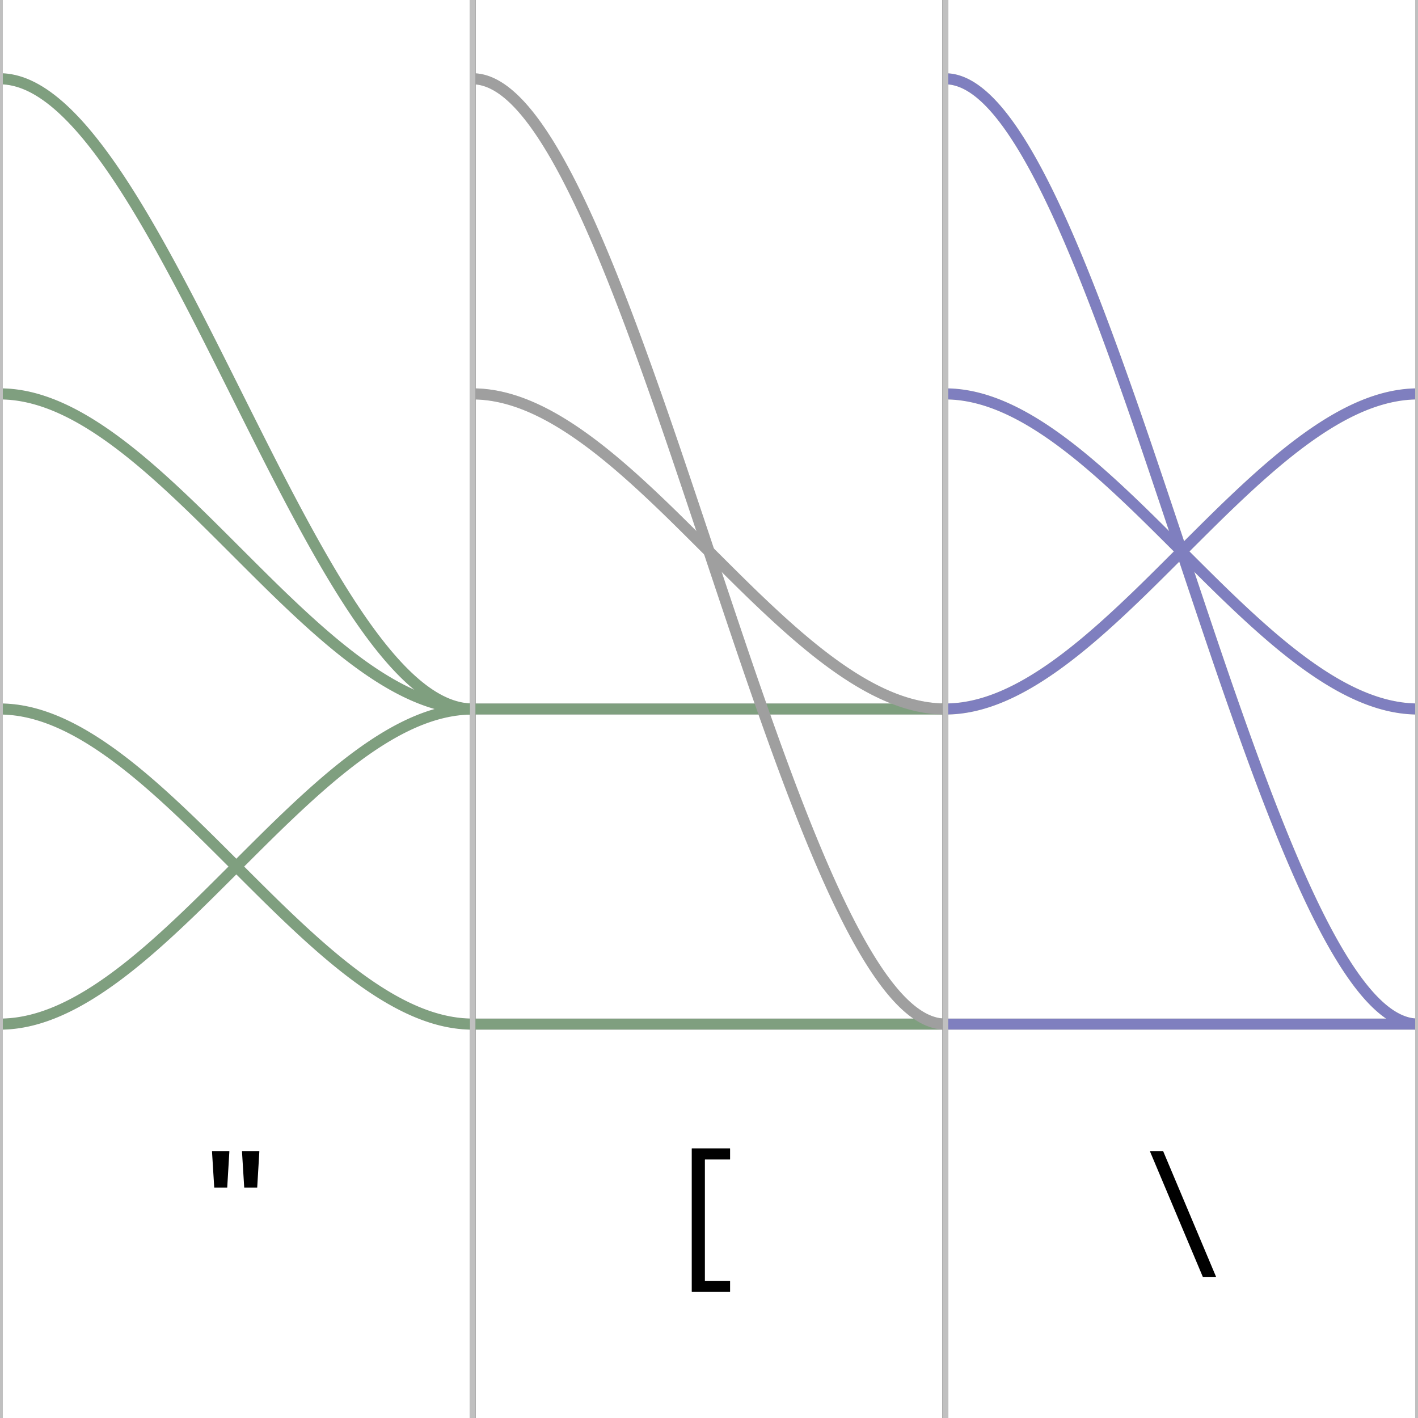

Slide 107
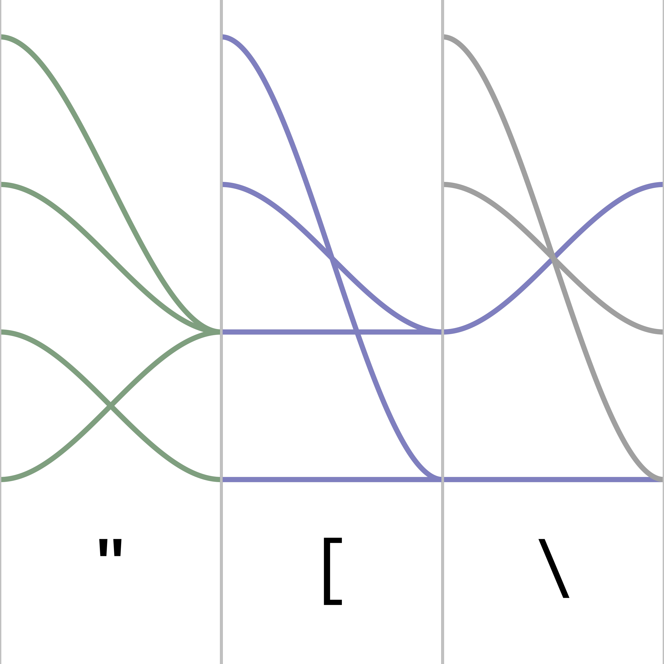

Slide 108
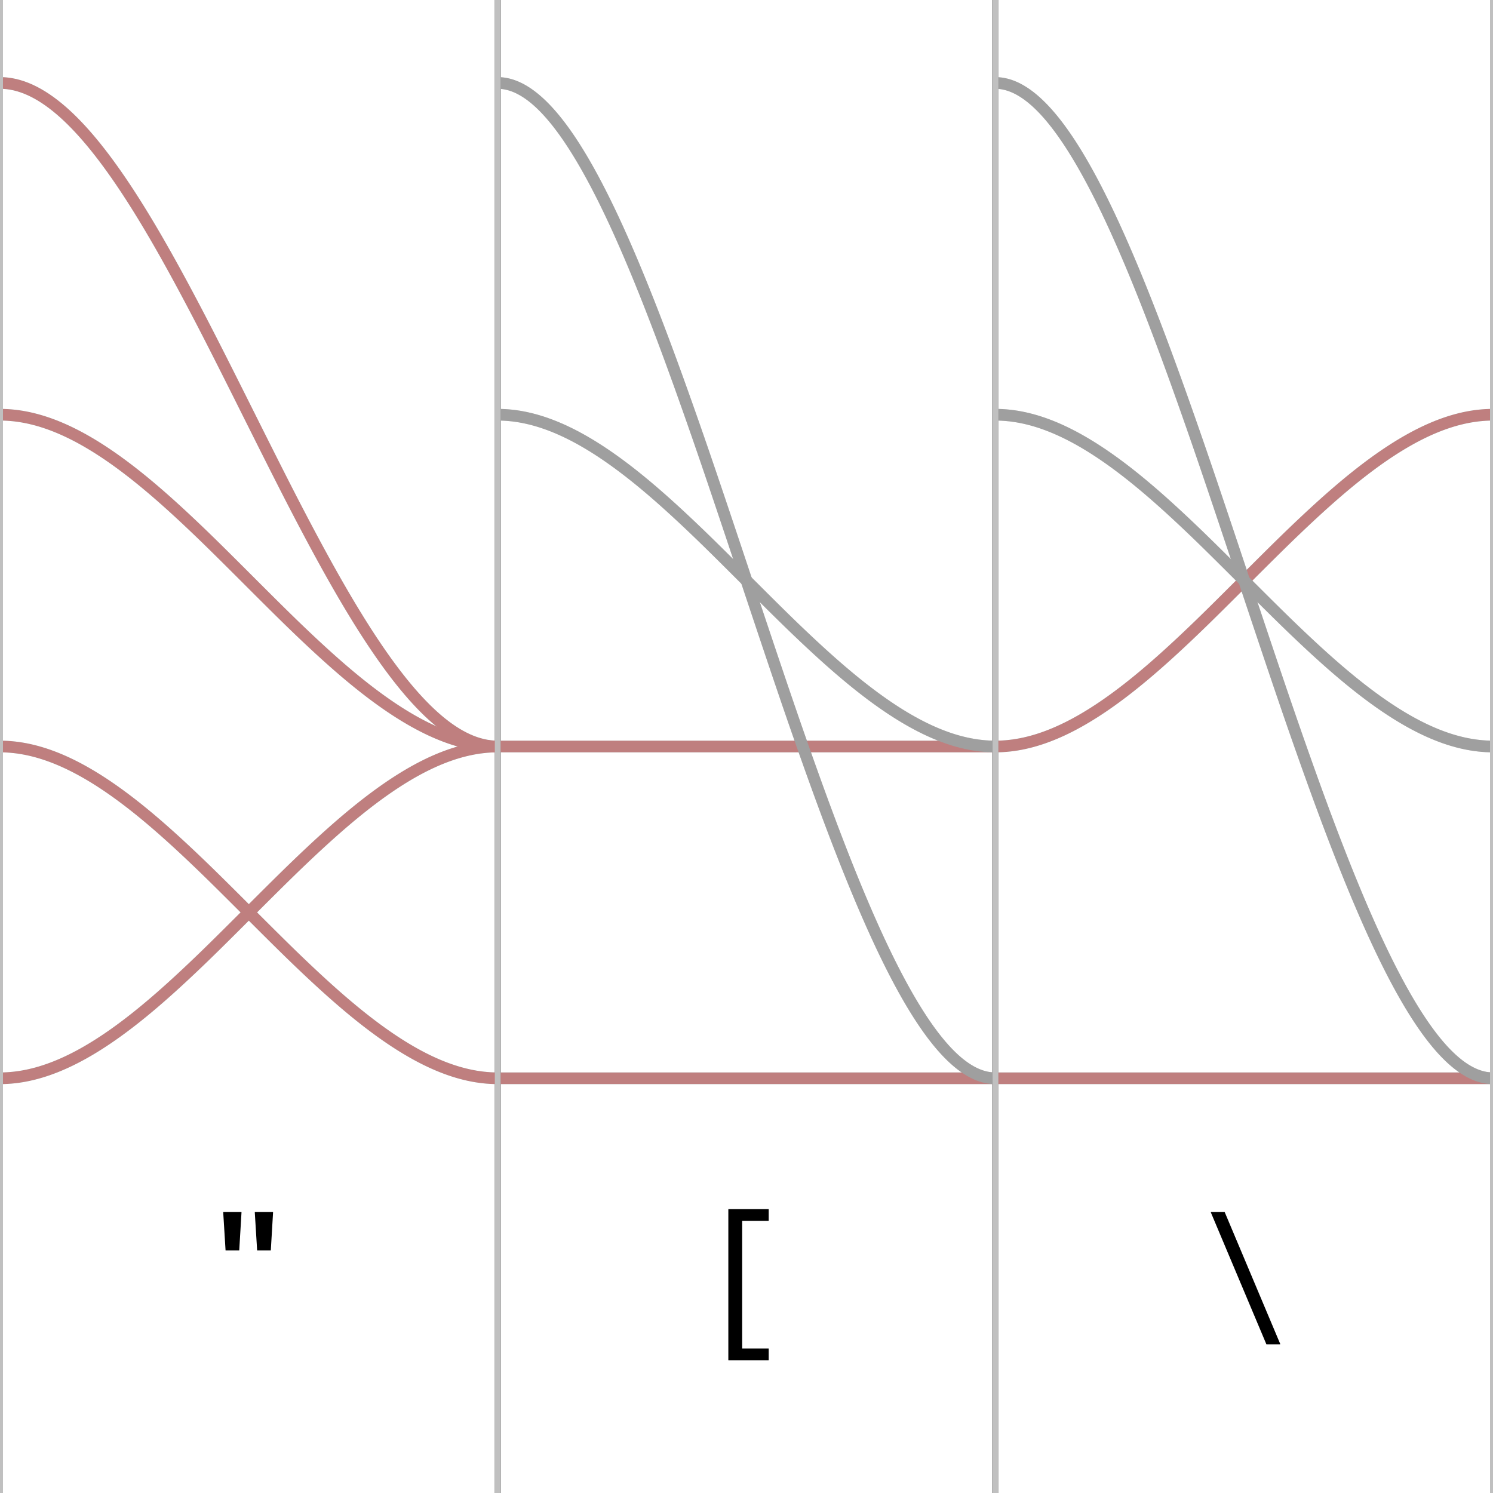

Slide 109
Semigroup

Slide 110
step :: State -> Input -> State

Slide 111
step :: State -> Input -> State
(`step` input) :: State -> State

Slide 112
step :: State -> Input -> State
(`step` input) :: State -> State :: a -> a

Slide 113
step :: State -> Input -> State
(`step` input) :: State -> State :: a -> a
f, g, h :: a -> a

Slide 114
step :: State -> Input -> State
(`step` input) :: State -> State :: a -> a
f, g, h :: a -> a
(f . g) . h = f . (g . h) -- associative

Slide 115
step :: State -> Input -> State
(`step` input) :: State -> State :: a -> a
f, g, h :: a -> a
(f . g) . h = f . (g . h) -- associative
Semigroup

Slide 116
step :: State -> Input -> State
(`step` input) :: State -> State :: a -> a
f, g, h :: a -> a
(f . g) . h = f . (g . h) -- associative
id . f = f -- left identity
f . id = f -- right identity
Semigroup

Slide 117
step :: State -> Input -> State
(`step` input) :: State -> State :: a -> a
f, g, h :: a -> a
(f . g) . h = f . (g . h) -- associative
f . id = f -- left identity
id . f = f -- right identity
Semigroup
Monoid

Slide 118
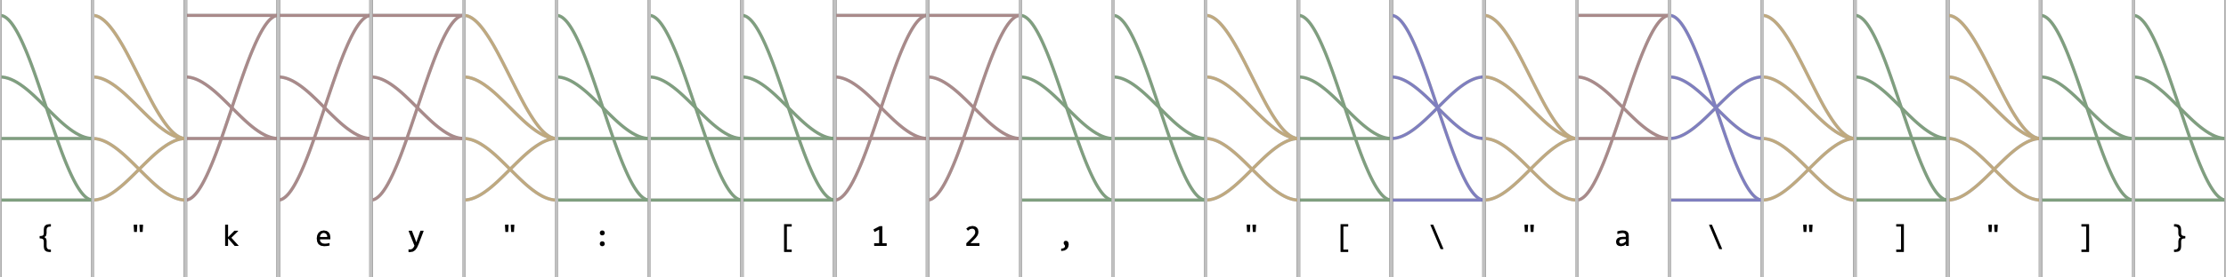

Slide 120
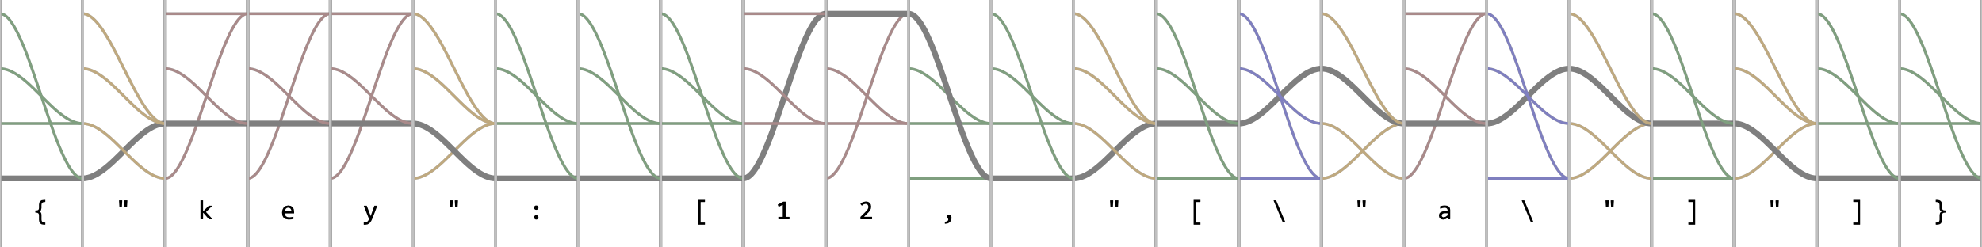

Slide 121
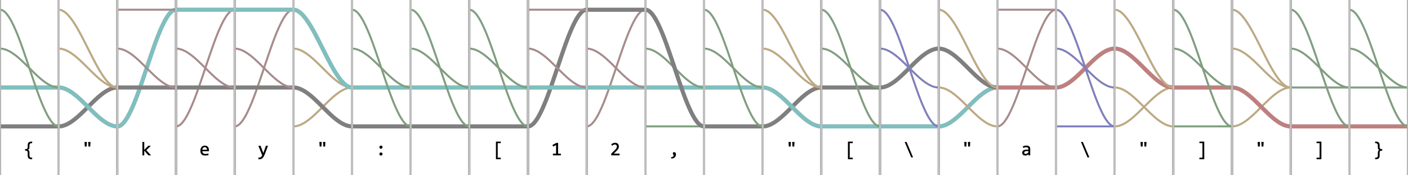

Slide 122
uint32_t hw_json_simd_transition_table_32[] =
{ 0x00010100, 0x00010100, 0x00010100, 0x00010100, 0x00010100, 0x00010100, 0x00010100, 0x00010100
, 0x00010100, 0x00010100, 0x00010100, 0x00010100, 0x00010100, 0x00010100, 0x00010100, 0x00010100
, 0x00010100, 0x00010100, 0x00010100, 0x00010100, 0x00010100, 0x00010100, 0x00010100, 0x00010100
, 0x00010100, 0x00010100, 0x00010100, 0x00010100, 0x00010100, 0x00010100, 0x00010100, 0x00010100
, 0x00010100, 0x00010100, 0x01010001, 0x00010100, 0x00010100, 0x00010100, 0x00010100, 0x00010100
, 0x00010100, 0x00010100, 0x00010100, 0x03010103, 0x00010100, 0x03010103, 0x03010103, 0x00010100
, 0x03010103, 0x03010103, 0x03010103, 0x03010103, 0x03010103, 0x03010103, 0x03010103, 0x03010103
, 0x03010103, 0x03010103, 0x00010100, 0x00010100, 0x00010100, 0x00010100, 0x00010100, 0x00010100
, 0x00010100, 0x03010103, 0x03010103, 0x03010103, 0x03010103, 0x03010103, 0x03010103, 0x03010103
, 0x03010103, 0x03010103, 0x03010103, 0x03010103, 0x03010103, 0x03010103, 0x03010103, 0x03010103
, 0x03010103, 0x03010103, 0x03010103, 0x03010103, 0x03010103, 0x03010103, 0x03010103, 0x03010103
, 0x03010103, 0x03010103, 0x03010103, 0x00010100, 0x00010200, 0x00010100, 0x00010100, 0x00010100
, 0x00010100, 0x03010103, 0x03010103, 0x03010103, 0x03010103, 0x03010103, 0x03010103, 0x03010103
, 0x03010103, 0x03010103, 0x03010103, 0x03010103, 0x03010103, 0x03010103, 0x03010103, 0x03010103
, 0x03010103, 0x03010103, 0x03010103, 0x03010103, 0x03010103, 0x03010103, 0x03010103, 0x03010103
, 0x03010103, 0x03010103, 0x03010103, 0x00010100, 0x00010100, 0x00010100, 0x00010100, 0x00010100
, 0x00010100, 0x00010100, 0x00010100, 0x00010100, 0x00010100, 0x00010100, 0x00010100, 0x00010100
, 0x00010100, 0x00010100, 0x00010100, 0x00010100, 0x00010100, 0x00010100, 0x00010100, 0x00010100
, 0x00010100, 0x00010100, 0x00010100, 0x00010100, 0x00010100, 0x00010100, 0x00010100, 0x00010100
, 0x00010100, 0x00010100, 0x00010100, 0x00010100, 0x00010100, 0x00010100, 0x00010100, 0x00010100
, 0x00010100, 0x00010100, 0x00010100, 0x00010100, 0x00010100, 0x00010100, 0x00010100, 0x00010100
, 0x00010100, 0x00010100, 0x00010100, 0x00010100, 0x00010100, 0x00010100, 0x00010100, 0x00010100
, 0x00010100, 0x00010100, 0x00010100, 0x00010100, 0x00010100, 0x00010100, 0x00010100, 0x00010100
, 0x00010100, 0x00010100, 0x00010100, 0x00010100, 0x00010100, 0x00010100, 0x00010100, 0x00010100
, 0x00010100, 0x00010100, 0x00010100, 0x00010100, 0x00010100, 0x00010100, 0x00010100, 0x00010100
, 0x00010100, 0x00010100, 0x00010100, 0x00010100, 0x00010100, 0x00010100, 0x00010100, 0x00010100
, 0x00010100, 0x00010100, 0x00010100, 0x00010100, 0x00010100, 0x00010100, 0x00010100, 0x00010100
, 0x00010100, 0x00010100, 0x00010100, 0x00010100, 0x00010100, 0x00010100, 0x00010100, 0x00010100
, 0x00010100, 0x00010100, 0x00010100, 0x00010100, 0x00010100, 0x00010100, 0x00010100, 0x00010100
, 0x00010100, 0x00010100, 0x00010100, 0x00010100, 0x00010100, 0x00010100, 0x00010100, 0x00010100
, 0x00010100, 0x00010100, 0x00010100, 0x00010100, 0x00010100, 0x00010100, 0x00010100, 0x00010100
, 0x00010100, 0x00010100, 0x00010100, 0x00010100, 0x00010100, 0x00010100, 0x00010100, 0x00010100
};

Slide 123
uint32_t hw_json_simd_transition_table_32[] =
{ 0x00010100, 0x00010100, 0x00010100, 0x00010100, 0x00010100, 0x00010100, 0x00010100, 0x00010100
, 0x00010100, 0x00010100, 0x00010100, 0x00010100, 0x00010100, 0x00010100, 0x00010100, 0x00010100
, 0x00010100, 0x00010100, 0x00010100, 0x00010100, 0x00010100, 0x00010100, 0x00010100, 0x00010100
, 0x00010100, 0x00010100, 0x00010100, 0x00010100, 0x00010100, 0x00010100, 0x00010100, 0x00010100
, 0x00010100, 0x00010100, 0x01010001, 0x00010100, 0x00010100, 0x00010100, 0x00010100, 0x00010100
, 0x00010100, 0x00010100, 0x00010100, 0x03010103, 0x00010100, 0x03010103, 0x03010103, 0x00010100
, 0x03010103, 0x03010103, 0x03010103, 0x03010103, 0x03010103, 0x03010103, 0x03010103, 0x03010103
, 0x03010103, 0x03010103, 0x00010100, 0x00010100, 0x00010100, 0x00010100, 0x00010100, 0x00010100
, 0x00010100, 0x03010103, 0x03010103, 0x03010103, 0x03010103, 0x03010103, 0x03010103, 0x03010103
, 0x03010103, 0x03010103, 0x03010103, 0x03010103, 0x03010103, 0x03010103, 0x03010103, 0x03010103
, 0x03010103, 0x03010103, 0x03010103, 0x03010103, 0x03010103, 0x03010103, 0x03010103, 0x03010103
, 0x03010103, 0x03010103, 0x03010103, 0x00010100, 0x00010200, 0x00010100, 0x00010100, 0x00010100
, 0x00010100, 0x03010103, 0x03010103, 0x03010103, 0x03010103, 0x03010103, 0x03010103, 0x03010103
, 0x03010103, 0x03010103, 0x03010103, 0x03010103, 0x03010103, 0x03010103, 0x03010103, 0x03010103
, 0x03010103, 0x03010103, 0x03010103, 0x03010103, 0x03010103, 0x03010103, 0x03010103, 0x03010103
, 0x03010103, 0x03010103, 0x03010103, 0x00010100, 0x00010100, 0x00010100, 0x00010100, 0x00010100
, 0x00010100, 0x00010100, 0x00010100, 0x00010100, 0x00010100, 0x00010100, 0x00010100, 0x00010100
, 0x00010100, 0x00010100, 0x00010100, 0x00010100, 0x00010100, 0x00010100, 0x00010100, 0x00010100
, 0x00010100, 0x00010100, 0x00010100, 0x00010100, 0x00010100, 0x00010100, 0x00010100, 0x00010100
, 0x00010100, 0x00010100, 0x00010100, 0x00010100, 0x00010100, 0x00010100, 0x00010100, 0x00010100
, 0x00010100, 0x00010100, 0x00010100, 0x00010100, 0x00010100, 0x00010100, 0x00010100, 0x00010100
, 0x00010100, 0x00010100, 0x00010100, 0x00010100, 0x00010100, 0x00010100, 0x00010100, 0x00010100
, 0x00010100, 0x00010100, 0x00010100, 0x00010100, 0x00010100, 0x00010100, 0x00010100, 0x00010100
, 0x00010100, 0x00010100, 0x00010100, 0x00010100, 0x00010100, 0x00010100, 0x00010100, 0x00010100
, 0x00010100, 0x00010100, 0x00010100, 0x00010100, 0x00010100, 0x00010100, 0x00010100, 0x00010100
, 0x00010100, 0x00010100, 0x00010100, 0x00010100, 0x00010100, 0x00010100, 0x00010100, 0x00010100
, 0x00010100, 0x00010100, 0x00010100, 0x00010100, 0x00010100, 0x00010100, 0x00010100, 0x00010100
, 0x00010100, 0x00010100, 0x00010100, 0x00010100, 0x00010100, 0x00010100, 0x00010100, 0x00010100
, 0x00010100, 0x00010100, 0x00010100, 0x00010100, 0x00010100, 0x00010100, 0x00010100, 0x00010100
, 0x00010100, 0x00010100, 0x00010100, 0x00010100, 0x00010100, 0x00010100, 0x00010100, 0x00010100
, 0x00010100, 0x00010100, 0x00010100, 0x00010100, 0x00010100, 0x00010100, 0x00010100, 0x00010100
, 0x00010100, 0x00010100, 0x00010100, 0x00010100, 0x00010100, 0x00010100, 0x00010100, 0x00010100
};

Slide 124
uint32_t hw_json_simd_transition_table_32[] =
{ 0x00010100, 0x00010100, 0x00010100, 0x00010100, 0x00010100, 0x00010100, 0x00010100, 0x00010100
, 0x00010100, 0x00010100, 0x00010100, 0x00010100, 0x00010100, 0x00010100, 0x00010100, 0x00010100
, 0x00010100, 0x00010100, 0x00010100, 0x00010100, 0x00010100, 0x00010100, 0x00010100, 0x00010100
, 0x00010100, 0x00010100, 0x00010100, 0x00010100, 0x00010100, 0x00010100, 0x00010100, 0x00010100
, 0x00010100, 0x00010100, 0x01010001, 0x00010100, 0x00010100, 0x00010100, 0x00010100, 0x00010100
, 0x00010100, 0x00010100, 0x00010100, 0x03010103, 0x00010100, 0x03010103, 0x03010103, 0x00010100
, 0x03010103, 0x03010103, 0x03010103, 0x03010103, 0x03010103, 0x03010103, 0x03010103, 0x03010103
, 0x03010103, 0x03010103, 0x00010100, 0x00010100, 0x00010100, 0x00010100, 0x00010100, 0x00010100
, 0x00010100, 0x03010103, 0x03010103, 0x03010103, 0x03010103, 0x03010103, 0x03010103, 0x03010103
, 0x03010103, 0x03010103, 0x03010103, 0x03010103, 0x03010103, 0x03010103, 0x03010103, 0x03010103
, 0x03010103, 0x03010103, 0x03010103, 0x03010103, 0x03010103, 0x03010103, 0x03010103, 0x03010103
, 0x03010103, 0x03010103, 0x03010103, 0x00010100, 0x00010200, 0x00010100, 0x00010100, 0x00010100
, 0x00010100, 0x03010103, 0x03010103, 0x03010103, 0x03010103, 0x03010103, 0x03010103, 0x03010103
, 0x03010103, 0x03010103, 0x03010103, 0x03010103, 0x03010103, 0x03010103, 0x03010103, 0x03010103
, 0x03010103, 0x03010103, 0x03010103, 0x03010103, 0x03010103, 0x03010103, 0x03010103, 0x03010103
, 0x03010103, 0x03010103, 0x03010103, 0x00010100, 0x00010100, 0x00010100, 0x00010100, 0x00010100
, 0x00010100, 0x00010100, 0x00010100, 0x00010100, 0x00010100, 0x00010100, 0x00010100, 0x00010100
, 0x00010100, 0x00010100, 0x00010100, 0x00010100, 0x00010100, 0x00010100, 0x00010100, 0x00010100
, 0x00010100, 0x00010100, 0x00010100, 0x00010100, 0x00010100, 0x00010100, 0x00010100, 0x00010100
, 0x00010100, 0x00010100, 0x00010100, 0x00010100, 0x00010100, 0x00010100, 0x00010100, 0x00010100
, 0x00010100, 0x00010100, 0x00010100, 0x00010100, 0x00010100, 0x00010100, 0x00010100, 0x00010100
, 0x00010100, 0x00010100, 0x00010100, 0x00010100, 0x00010100, 0x00010100, 0x00010100, 0x00010100
, 0x00010100, 0x00010100, 0x00010100, 0x00010100, 0x00010100, 0x00010100, 0x00010100, 0x00010100
, 0x00010100, 0x00010100, 0x00010100, 0x00010100, 0x00010100, 0x00010100, 0x00010100, 0x00010100
, 0x00010100, 0x00010100, 0x00010100, 0x00010100, 0x00010100, 0x00010100, 0x00010100, 0x00010100
, 0x00010100, 0x00010100, 0x00010100, 0x00010100, 0x00010100, 0x00010100, 0x00010100, 0x00010100
, 0x00010100, 0x00010100, 0x00010100, 0x00010100, 0x00010100, 0x00010100, 0x00010100, 0x00010100
, 0x00010100, 0x00010100, 0x00010100, 0x00010100, 0x00010100, 0x00010100, 0x00010100, 0x00010100
, 0x00010100, 0x00010100, 0x00010100, 0x00010100, 0x00010100, 0x00010100, 0x00010100, 0x00010100
, 0x00010100, 0x00010100, 0x00010100, 0x00010100, 0x00010100, 0x00010100, 0x00010100, 0x00010100
, 0x00010100, 0x00010100, 0x00010100, 0x00010100, 0x00010100, 0x00010100, 0x00010100, 0x00010100
, 0x00010100, 0x00010100, 0x00010100, 0x00010100, 0x00010100, 0x00010100, 0x00010100, 0x00010100
};
"
+
-
.
0-9
A-Z
\
a-z

Slide 125
uint32_t hw_json_simd_phi_table_32[] =
{ 0x00000000, 0x00000000, 0x00000000, 0x00000000, 0x00000000, 0x00000000, 0x00000000, 0x00000000
, 0x00000000, 0x00000000, 0x00000000, 0x00000000, 0x00000000, 0x00000000, 0x00000000, 0x00000000
, 0x00000000, 0x00000000, 0x00000000, 0x00000000, 0x00000000, 0x00000000, 0x00000000, 0x00000000
, 0x00000000, 0x00000000, 0x00000000, 0x00000000, 0x00000000, 0x00000000, 0x00000000, 0x00000000
, 0x00000000, 0x00000000, 0x00000007, 0x00000000, 0x00000000, 0x00000000, 0x00000000, 0x00000000
, 0x00000000, 0x00000000, 0x00000000, 0x00000007, 0x00000000, 0x00000007, 0x00000007, 0x00000000
, 0x00000007, 0x00000007, 0x00000007, 0x00000007, 0x00000007, 0x00000007, 0x00000007, 0x00000007
, 0x00000007, 0x00000007, 0x00000000, 0x00000000, 0x00000000, 0x00000000, 0x00000000, 0x00000000
, 0x00000000, 0x00000007, 0x00000007, 0x00000007, 0x00000007, 0x00000007, 0x00000007, 0x00000007
, 0x00000007, 0x00000007, 0x00000007, 0x00000007, 0x00000007, 0x00000007, 0x00000007, 0x00000007
, 0x00000007, 0x00000007, 0x00000007, 0x00000007, 0x00000007, 0x00000007, 0x00000007, 0x00000007
, 0x00000007, 0x00000007, 0x00000007, 0x06000006, 0x00000000, 0x01000001, 0x00000000, 0x00000000
, 0x00000000, 0x00000007, 0x00000007, 0x00000007, 0x00000007, 0x00000007, 0x00000007, 0x00000007
, 0x00000007, 0x00000007, 0x00000007, 0x00000007, 0x00000007, 0x00000007, 0x00000007, 0x00000007
, 0x00000007, 0x00000007, 0x00000007, 0x00000007, 0x00000007, 0x00000007, 0x00000007, 0x00000007
, 0x00000007, 0x00000007, 0x00000007, 0x06000006, 0x00000000, 0x01000001, 0x00000000, 0x00000000
, 0x00000000, 0x00000000, 0x00000000, 0x00000000, 0x00000000, 0x00000000, 0x00000000, 0x00000000
, 0x00000000, 0x00000000, 0x00000000, 0x00000000, 0x00000000, 0x00000000, 0x00000000, 0x00000000
, 0x00000000, 0x00000000, 0x00000000, 0x00000000, 0x00000000, 0x00000000, 0x00000000, 0x00000000
, 0x00000000, 0x00000000, 0x00000000, 0x00000000, 0x00000000, 0x00000000, 0x00000000, 0x00000000
, 0x00000000, 0x00000000, 0x00000000, 0x00000000, 0x00000000, 0x00000000, 0x00000000, 0x00000000
, 0x00000000, 0x00000000, 0x00000000, 0x00000000, 0x00000000, 0x00000000, 0x00000000, 0x00000000
, 0x00000000, 0x00000000, 0x00000000, 0x00000000, 0x00000000, 0x00000000, 0x00000000, 0x00000000
, 0x00000000, 0x00000000, 0x00000000, 0x00000000, 0x00000000, 0x00000000, 0x00000000, 0x00000000
, 0x00000000, 0x00000000, 0x00000000, 0x00000000, 0x00000000, 0x00000000, 0x00000000, 0x00000000
, 0x00000000, 0x00000000, 0x00000000, 0x00000000, 0x00000000, 0x00000000, 0x00000000, 0x00000000
, 0x00000000, 0x00000000, 0x00000000, 0x00000000, 0x00000000, 0x00000000, 0x00000000, 0x00000000
, 0x00000000, 0x00000000, 0x00000000, 0x00000000, 0x00000000, 0x00000000, 0x00000000, 0x00000000
, 0x00000000, 0x00000000, 0x00000000, 0x00000000, 0x00000000, 0x00000000, 0x00000000, 0x00000000
, 0x00000000, 0x00000000, 0x00000000, 0x00000000, 0x00000000, 0x00000000, 0x00000000, 0x00000000
, 0x00000000, 0x00000000, 0x00000000, 0x00000000, 0x00000000, 0x00000000, 0x00000000, 0x00000000
, 0x00000000, 0x00000000, 0x00000000, 0x00000000, 0x00000000, 0x00000000, 0x00000000, 0x00000000
};

Slide 126
uint32_t hw_json_simd_phi_table_32[] =
{ 0x00000000, 0x00000000, 0x00000000, 0x00000000, 0x00000000, 0x00000000, 0x00000000, 0x00000000
, 0x00000000, 0x00000000, 0x00000000, 0x00000000, 0x00000000, 0x00000000, 0x00000000, 0x00000000
, 0x00000000, 0x00000000, 0x00000000, 0x00000000, 0x00000000, 0x00000000, 0x00000000, 0x00000000
, 0x00000000, 0x00000000, 0x00000000, 0x00000000, 0x00000000, 0x00000000, 0x00000000, 0x00000000
, 0x00000000, 0x00000000, 0x00000007, 0x00000000, 0x00000000, 0x00000000, 0x00000000, 0x00000000
, 0x00000000, 0x00000000, 0x00000000, 0x00000007, 0x00000000, 0x00000007, 0x00000007, 0x00000000
, 0x00000007, 0x00000007, 0x00000007, 0x00000007, 0x00000007, 0x00000007, 0x00000007, 0x00000007
, 0x00000007, 0x00000007, 0x00000000, 0x00000000, 0x00000000, 0x00000000, 0x00000000, 0x00000000
, 0x00000000, 0x00000007, 0x00000007, 0x00000007, 0x00000007, 0x00000007, 0x00000007, 0x00000007
, 0x00000007, 0x00000007, 0x00000007, 0x00000007, 0x00000007, 0x00000007, 0x00000007, 0x00000007
, 0x00000007, 0x00000007, 0x00000007, 0x00000007, 0x00000007, 0x00000007, 0x00000007, 0x00000007
, 0x00000007, 0x00000007, 0x00000007, 0x06000006, 0x00000000, 0x01000001, 0x00000000, 0x00000000
, 0x00000000, 0x00000007, 0x00000007, 0x00000007, 0x00000007, 0x00000007, 0x00000007, 0x00000007
, 0x00000007, 0x00000007, 0x00000007, 0x00000007, 0x00000007, 0x00000007, 0x00000007, 0x00000007
, 0x00000007, 0x00000007, 0x00000007, 0x00000007, 0x00000007, 0x00000007, 0x00000007, 0x00000007
, 0x00000007, 0x00000007, 0x00000007, 0x06000006, 0x00000000, 0x01000001, 0x00000000, 0x00000000
, 0x00000000, 0x00000000, 0x00000000, 0x00000000, 0x00000000, 0x00000000, 0x00000000, 0x00000000
, 0x00000000, 0x00000000, 0x00000000, 0x00000000, 0x00000000, 0x00000000, 0x00000000, 0x00000000
, 0x00000000, 0x00000000, 0x00000000, 0x00000000, 0x00000000, 0x00000000, 0x00000000, 0x00000000
, 0x00000000, 0x00000000, 0x00000000, 0x00000000, 0x00000000, 0x00000000, 0x00000000, 0x00000000
, 0x00000000, 0x00000000, 0x00000000, 0x00000000, 0x00000000, 0x00000000, 0x00000000, 0x00000000
, 0x00000000, 0x00000000, 0x00000000, 0x00000000, 0x00000000, 0x00000000, 0x00000000, 0x00000000
, 0x00000000, 0x00000000, 0x00000000, 0x00000000, 0x00000000, 0x00000000, 0x00000000, 0x00000000
, 0x00000000, 0x00000000, 0x00000000, 0x00000000, 0x00000000, 0x00000000, 0x00000000, 0x00000000
, 0x00000000, 0x00000000, 0x00000000, 0x00000000, 0x00000000, 0x00000000, 0x00000000, 0x00000000
, 0x00000000, 0x00000000, 0x00000000, 0x00000000, 0x00000000, 0x00000000, 0x00000000, 0x00000000
, 0x00000000, 0x00000000, 0x00000000, 0x00000000, 0x00000000, 0x00000000, 0x00000000, 0x00000000
, 0x00000000, 0x00000000, 0x00000000, 0x00000000, 0x00000000, 0x00000000, 0x00000000, 0x00000000
, 0x00000000, 0x00000000, 0x00000000, 0x00000000, 0x00000000, 0x00000000, 0x00000000, 0x00000000
, 0x00000000, 0x00000000, 0x00000000, 0x00000000, 0x00000000, 0x00000000, 0x00000000, 0x00000000
, 0x00000000, 0x00000000, 0x00000000, 0x00000000, 0x00000000, 0x00000000, 0x00000000, 0x00000000
, 0x00000000, 0x00000000, 0x00000000, 0x00000000, 0x00000000, 0x00000000, 0x00000000, 0x00000000
};

Slide 127
uint32_t hw_json_simd_phi_table_32[] =
{ 0x00000000, 0x00000000, 0x00000000, 0x00000000, 0x00000000, 0x00000000, 0x00000000, 0x00000000
, 0x00000000, 0x00000000, 0x00000000, 0x00000000, 0x00000000, 0x00000000, 0x00000000, 0x00000000
, 0x00000000, 0x00000000, 0x00000000, 0x00000000, 0x00000000, 0x00000000, 0x00000000, 0x00000000
, 0x00000000, 0x00000000, 0x00000000, 0x00000000, 0x00000000, 0x00000000, 0x00000000, 0x00000000
, 0x00000000, 0x00000000, 0x00000007, 0x00000000, 0x00000000, 0x00000000, 0x00000000, 0x00000000
, 0x00000000, 0x00000000, 0x00000000, 0x00000007, 0x00000000, 0x00000007, 0x00000007, 0x00000000
, 0x00000007, 0x00000007, 0x00000007, 0x00000007, 0x00000007, 0x00000007, 0x00000007, 0x00000007
, 0x00000007, 0x00000007, 0x00000000, 0x00000000, 0x00000000, 0x00000000, 0x00000000, 0x00000000
, 0x00000000, 0x00000007, 0x00000007, 0x00000007, 0x00000007, 0x00000007, 0x00000007, 0x00000007
, 0x00000007, 0x00000007, 0x00000007, 0x00000007, 0x00000007, 0x00000007, 0x00000007, 0x00000007
, 0x00000007, 0x00000007, 0x00000007, 0x00000007, 0x00000007, 0x00000007, 0x00000007, 0x00000007
, 0x00000007, 0x00000007, 0x00000007, 0x06000006, 0x00000000, 0x01000001, 0x00000000, 0x00000000
, 0x00000000, 0x00000007, 0x00000007, 0x00000007, 0x00000007, 0x00000007, 0x00000007, 0x00000007
, 0x00000007, 0x00000007, 0x00000007, 0x00000007, 0x00000007, 0x00000007, 0x00000007, 0x00000007
, 0x00000007, 0x00000007, 0x00000007, 0x00000007, 0x00000007, 0x00000007, 0x00000007, 0x00000007
, 0x00000007, 0x00000007, 0x00000007, 0x06000006, 0x00000000, 0x01000001, 0x00000000, 0x00000000
, 0x00000000, 0x00000000, 0x00000000, 0x00000000, 0x00000000, 0x00000000, 0x00000000, 0x00000000
, 0x00000000, 0x00000000, 0x00000000, 0x00000000, 0x00000000, 0x00000000, 0x00000000, 0x00000000
, 0x00000000, 0x00000000, 0x00000000, 0x00000000, 0x00000000, 0x00000000, 0x00000000, 0x00000000
, 0x00000000, 0x00000000, 0x00000000, 0x00000000, 0x00000000, 0x00000000, 0x00000000, 0x00000000
, 0x00000000, 0x00000000, 0x00000000, 0x00000000, 0x00000000, 0x00000000, 0x00000000, 0x00000000
, 0x00000000, 0x00000000, 0x00000000, 0x00000000, 0x00000000, 0x00000000, 0x00000000, 0x00000000
, 0x00000000, 0x00000000, 0x00000000, 0x00000000, 0x00000000, 0x00000000, 0x00000000, 0x00000000
, 0x00000000, 0x00000000, 0x00000000, 0x00000000, 0x00000000, 0x00000000, 0x00000000, 0x00000000
, 0x00000000, 0x00000000, 0x00000000, 0x00000000, 0x00000000, 0x00000000, 0x00000000, 0x00000000
, 0x00000000, 0x00000000, 0x00000000, 0x00000000, 0x00000000, 0x00000000, 0x00000000, 0x00000000
, 0x00000000, 0x00000000, 0x00000000, 0x00000000, 0x00000000, 0x00000000, 0x00000000, 0x00000000
, 0x00000000, 0x00000000, 0x00000000, 0x00000000, 0x00000000, 0x00000000, 0x00000000, 0x00000000
, 0x00000000, 0x00000000, 0x00000000, 0x00000000, 0x00000000, 0x00000000, 0x00000000, 0x00000000
, 0x00000000, 0x00000000, 0x00000000, 0x00000000, 0x00000000, 0x00000000, 0x00000000, 0x00000000
, 0x00000000, 0x00000000, 0x00000000, 0x00000000, 0x00000000, 0x00000000, 0x00000000, 0x00000000
, 0x00000000, 0x00000000, 0x00000000, 0x00000000, 0x00000000, 0x00000000, 0x00000000, 0x00000000
};
"
+
-
.
0-9
A-Z
[
\
]
a-z
[
}

Slide 128
uint32_t hw_json_simd_phi_table_32[] =
{ 0x00000000, 0x00000000, 0x00000000, 0x00000000, 0x00000000, 0x00000000, 0x00000000, 0x00000000
, 0x00000000, 0x00000000, 0x00000000, 0x00000000, 0x00000000, 0x00000000, 0x00000000, 0x00000000
, 0x00000000, 0x00000000, 0x00000000, 0x00000000, 0x00000000, 0x00000000, 0x00000000, 0x00000000
, 0x00000000, 0x00000000, 0x00000000, 0x00000000, 0x00000000, 0x00000000, 0x00000000, 0x00000000
, 0x00000000, 0x00000000, 0x00000007, 0x00000000, 0x00000000, 0x00000000, 0x00000000, 0x00000000
, 0x00000000, 0x00000000, 0x00000000, 0x00000007, 0x00000000, 0x00000007, 0x00000007, 0x00000000
, 0x00000007, 0x00000007, 0x00000007, 0x00000007, 0x00000007, 0x00000007, 0x00000007, 0x00000007
, 0x00000007, 0x00000007, 0x00000000, 0x00000000, 0x00000000, 0x00000000, 0x00000000, 0x00000000
, 0x00000000, 0x00000007, 0x00000007, 0x00000007, 0x00000007, 0x00000007, 0x00000007, 0x00000007
, 0x00000007, 0x00000007, 0x00000007, 0x00000007, 0x00000007, 0x00000007, 0x00000007, 0x00000007
, 0x00000007, 0x00000007, 0x00000007, 0x00000007, 0x00000007, 0x00000007, 0x00000007, 0x00000007
, 0x00000007, 0x00000007, 0x00000007, 0x06000006, 0x00000000, 0x01000001, 0x00000000, 0x00000000
, 0x00000000, 0x00000007, 0x00000007, 0x00000007, 0x00000007, 0x00000007, 0x00000007, 0x00000007
, 0x00000007, 0x00000007, 0x00000007, 0x00000007, 0x00000007, 0x00000007, 0x00000007, 0x00000007
, 0x00000007, 0x00000007, 0x00000007, 0x00000007, 0x00000007, 0x00000007, 0x00000007, 0x00000007
, 0x00000007, 0x00000007, 0x00000007, 0x06000006, 0x00000000, 0x01000001, 0x00000000, 0x00000000
, 0x00000000, 0x00000000, 0x00000000, 0x00000000, 0x00000000, 0x00000000, 0x00000000, 0x00000000
, 0x00000000, 0x00000000, 0x00000000, 0x00000000, 0x00000000, 0x00000000, 0x00000000, 0x00000000
, 0x00000000, 0x00000000, 0x00000000, 0x00000000, 0x00000000, 0x00000000, 0x00000000, 0x00000000
, 0x00000000, 0x00000000, 0x00000000, 0x00000000, 0x00000000, 0x00000000, 0x00000000, 0x00000000
, 0x00000000, 0x00000000, 0x00000000, 0x00000000, 0x00000000, 0x00000000, 0x00000000, 0x00000000
, 0x00000000, 0x00000000, 0x00000000, 0x00000000, 0x00000000, 0x00000000, 0x00000000, 0x00000000
, 0x00000000, 0x00000000, 0x00000000, 0x00000000, 0x00000000, 0x00000000, 0x00000000, 0x00000000
, 0x00000000, 0x00000000, 0x00000000, 0x00000000, 0x00000000, 0x00000000, 0x00000000, 0x00000000
, 0x00000000, 0x00000000, 0x00000000, 0x00000000, 0x00000000, 0x00000000, 0x00000000, 0x00000000
, 0x00000000, 0x00000000, 0x00000000, 0x00000000, 0x00000000, 0x00000000, 0x00000000, 0x00000000
, 0x00000000, 0x00000000, 0x00000000, 0x00000000, 0x00000000, 0x00000000, 0x00000000, 0x00000000
, 0x00000000, 0x00000000, 0x00000000, 0x00000000, 0x00000000, 0x00000000, 0x00000000, 0x00000000
, 0x00000000, 0x00000000, 0x00000000, 0x00000000, 0x00000000, 0x00000000, 0x00000000, 0x00000000
, 0x00000000, 0x00000000, 0x00000000, 0x00000000, 0x00000000, 0x00000000, 0x00000000, 0x00000000
, 0x00000000, 0x00000000, 0x00000000, 0x00000000, 0x00000000, 0x00000000, 0x00000000, 0x00000000
, 0x00000000, 0x00000000, 0x00000000, 0x00000000, 0x00000000, 0x00000000, 0x00000000, 0x00000000
};
"
+
-
.
0-9
A-Z
[
\
]
a-z
[
}

Slide 129
uint32_t hw_json_simd_phi_table_32[] =
{ 0x00000000, 0x00000000, 0x00000000, 0x00000000, 0x00000000, 0x00000000, 0x00000000, 0x00000000
, 0x00000000, 0x00000000, 0x00000000, 0x00000000, 0x00000000, 0x00000000, 0x00000000, 0x00000000
, 0x00000000, 0x00000000, 0x00000000, 0x00000000, 0x00000000, 0x00000000, 0x00000000, 0x00000000
, 0x00000000, 0x00000000, 0x00000000, 0x00000000, 0x00000000, 0x00000000, 0x00000000, 0x00000000
, 0x00000000, 0x00000000, 0x00000007, 0x00000000, 0x00000000, 0x00000000, 0x00000000, 0x00000000
, 0x00000000, 0x00000000, 0x00000000, 0x00000007, 0x00000000, 0x00000007, 0x00000007, 0x00000000
, 0x00000007, 0x00000007, 0x00000007, 0x00000007, 0x00000007, 0x00000007, 0x00000007, 0x00000007
, 0x00000007, 0x00000007, 0x00000000, 0x00000000, 0x00000000, 0x00000000, 0x00000000, 0x00000000
, 0x00000000, 0x00000007, 0x00000007, 0x00000007, 0x00000007, 0x00000007, 0x00000007, 0x00000007
, 0x00000007, 0x00000007, 0x00000007, 0x00000007, 0x00000007, 0x00000007, 0x00000007, 0x00000007
, 0x00000007, 0x00000007, 0x00000007, 0x00000007, 0x00000007, 0x00000007, 0x00000007, 0x00000007
, 0x00000007, 0x00000007, 0x00000007, 0x06000006, 0x00000000, 0x01000001, 0x00000000, 0x00000000
, 0x00000000, 0x00000007, 0x00000007, 0x00000007, 0x00000007, 0x00000007, 0x00000007, 0x00000007
, 0x00000007, 0x00000007, 0x00000007, 0x00000007, 0x00000007, 0x00000007, 0x00000007, 0x00000007
, 0x00000007, 0x00000007, 0x00000007, 0x00000007, 0x00000007, 0x00000007, 0x00000007, 0x00000007
, 0x00000007, 0x00000007, 0x00000007, 0x06000006, 0x00000000, 0x01000001, 0x00000000, 0x00000000
, 0x00000000, 0x00000000, 0x00000000, 0x00000000, 0x00000000, 0x00000000, 0x00000000, 0x00000000
, 0x00000000, 0x00000000, 0x00000000, 0x00000000, 0x00000000, 0x00000000, 0x00000000, 0x00000000
, 0x00000000, 0x00000000, 0x00000000, 0x00000000, 0x00000000, 0x00000000, 0x00000000, 0x00000000
, 0x00000000, 0x00000000, 0x00000000, 0x00000000, 0x00000000, 0x00000000, 0x00000000, 0x00000000
, 0x00000000, 0x00000000, 0x00000000, 0x00000000, 0x00000000, 0x00000000, 0x00000000, 0x00000000
, 0x00000000, 0x00000000, 0x00000000, 0x00000000, 0x00000000, 0x00000000, 0x00000000, 0x00000000
, 0x00000000, 0x00000000, 0x00000000, 0x00000000, 0x00000000, 0x00000000, 0x00000000, 0x00000000
, 0x00000000, 0x00000000, 0x00000000, 0x00000000, 0x00000000, 0x00000000, 0x00000000, 0x00000000
, 0x00000000, 0x00000000, 0x00000000, 0x00000000, 0x00000000, 0x00000000, 0x00000000, 0x00000000
, 0x00000000, 0x00000000, 0x00000000, 0x00000000, 0x00000000, 0x00000000, 0x00000000, 0x00000000
, 0x00000000, 0x00000000, 0x00000000, 0x00000000, 0x00000000, 0x00000000, 0x00000000, 0x00000000
, 0x00000000, 0x00000000, 0x00000000, 0x00000000, 0x00000000, 0x00000000, 0x00000000, 0x00000000
, 0x00000000, 0x00000000, 0x00000000, 0x00000000, 0x00000000, 0x00000000, 0x00000000, 0x00000000
, 0x00000000, 0x00000000, 0x00000000, 0x00000000, 0x00000000, 0x00000000, 0x00000000, 0x00000000
, 0x00000000, 0x00000000, 0x00000000, 0x00000000, 0x00000000, 0x00000000, 0x00000000, 0x00000000
, 0x00000000, 0x00000000, 0x00000000, 0x00000000, 0x00000000, 0x00000000, 0x00000000, 0x00000000
};
"
+
-
.
0-9
A-Z
[
\
]
a-z
[
}
IOC
7: 0111
6: 0110
1: 0001

Slide 130
uint32_t hw_json_simd_phi_table_32[] =
{ 0x00000000, 0x00000000, 0x00000000, 0x00000000, 0x00000000, 0x00000000, 0x00000000, 0x00000000
, 0x00000000, 0x00000000, 0x00000000, 0x00000000, 0x00000000, 0x00000000, 0x00000000, 0x00000000
, 0x00000000, 0x00000000, 0x00000000, 0x00000000, 0x00000000, 0x00000000, 0x00000000, 0x00000000
, 0x00000000, 0x00000000, 0x00000000, 0x00000000, 0x00000000, 0x00000000, 0x00000000, 0x00000000
, 0x00000000, 0x00000000, 0x00000007, 0x00000000, 0x00000000, 0x00000000, 0x00000000, 0x00000000
, 0x00000000, 0x00000000, 0x00000000, 0x00000007, 0x00000000, 0x00000007, 0x00000007, 0x00000000
, 0x00000007, 0x00000007, 0x00000007, 0x00000007, 0x00000007, 0x00000007, 0x00000007, 0x00000007
, 0x00000007, 0x00000007, 0x00000000, 0x00000000, 0x00000000, 0x00000000, 0x00000000, 0x00000000
, 0x00000000, 0x00000007, 0x00000007, 0x00000007, 0x00000007, 0x00000007, 0x00000007, 0x00000007
, 0x00000007, 0x00000007, 0x00000007, 0x00000007, 0x00000007, 0x00000007, 0x00000007, 0x00000007
, 0x00000007, 0x00000007, 0x00000007, 0x00000007, 0x00000007, 0x00000007, 0x00000007, 0x00000007
, 0x00000007, 0x00000007, 0x00000007, 0x06000006, 0x00000000, 0x01000001, 0x00000000, 0x00000000
, 0x00000000, 0x00000007, 0x00000007, 0x00000007, 0x00000007, 0x00000007, 0x00000007, 0x00000007
, 0x00000007, 0x00000007, 0x00000007, 0x00000007, 0x00000007, 0x00000007, 0x00000007, 0x00000007
, 0x00000007, 0x00000007, 0x00000007, 0x00000007, 0x00000007, 0x00000007, 0x00000007, 0x00000007
, 0x00000007, 0x00000007, 0x00000007, 0x06000006, 0x00000000, 0x01000001, 0x00000000, 0x00000000
, 0x00000000, 0x00000000, 0x00000000, 0x00000000, 0x00000000, 0x00000000, 0x00000000, 0x00000000
, 0x00000000, 0x00000000, 0x00000000, 0x00000000, 0x00000000, 0x00000000, 0x00000000, 0x00000000
, 0x00000000, 0x00000000, 0x00000000, 0x00000000, 0x00000000, 0x00000000, 0x00000000, 0x00000000
, 0x00000000, 0x00000000, 0x00000000, 0x00000000, 0x00000000, 0x00000000, 0x00000000, 0x00000000
, 0x00000000, 0x00000000, 0x00000000, 0x00000000, 0x00000000, 0x00000000, 0x00000000, 0x00000000
, 0x00000000, 0x00000000, 0x00000000, 0x00000000, 0x00000000, 0x00000000, 0x00000000, 0x00000000
, 0x00000000, 0x00000000, 0x00000000, 0x00000000, 0x00000000, 0x00000000, 0x00000000, 0x00000000
, 0x00000000, 0x00000000, 0x00000000, 0x00000000, 0x00000000, 0x00000000, 0x00000000, 0x00000000
, 0x00000000, 0x00000000, 0x00000000, 0x00000000, 0x00000000, 0x00000000, 0x00000000, 0x00000000
, 0x00000000, 0x00000000, 0x00000000, 0x00000000, 0x00000000, 0x00000000, 0x00000000, 0x00000000
, 0x00000000, 0x00000000, 0x00000000, 0x00000000, 0x00000000, 0x00000000, 0x00000000, 0x00000000
, 0x00000000, 0x00000000, 0x00000000, 0x00000000, 0x00000000, 0x00000000, 0x00000000, 0x00000000
, 0x00000000, 0x00000000, 0x00000000, 0x00000000, 0x00000000, 0x00000000, 0x00000000, 0x00000000
, 0x00000000, 0x00000000, 0x00000000, 0x00000000, 0x00000000, 0x00000000, 0x00000000, 0x00000000
, 0x00000000, 0x00000000, 0x00000000, 0x00000000, 0x00000000, 0x00000000, 0x00000000, 0x00000000
, 0x00000000, 0x00000000, 0x00000000, 0x00000000, 0x00000000, 0x00000000, 0x00000000, 0x00000000
};
"
+
-
.
0-9
A-Z
[
\
]
a-z
[
}
IOC
7: 1()
6: 1(
1: 0 )

Slide 131
Instructions
⇗ __m128i _mm_set_epi64x(__int64 e1, __int64 e0)
⇗ __m128i _mm_set1_epi32(int a)
⇗ __m128i _mm_shuffle_epi8(__m128i a, __m128i b)
⇗ int _mm_extract_epi32(__m128i a, const int imm8)
⇗ __m256i _mm256_slli_epi64(__m256i a, int imm8)
⇗ __m256i _mm256_srli_epi64(__m256i a, int imm8)
⇗ int _mm256_movemask_epi8(__m256i a)
⇗ unsigned __int64 _pext_u64(unsigned __int64 a, unsigned __int64 mask)
⇗ unsigned __int64 _pdep_u64(unsigned __int64 a, unsigned __int64 mask)
⇗ unsigned __int64 _mm_popcnt_u64(unsigned __int64 a)

Slide 132
Benchmarking:
Index Creation (State Machine SIMD)
$ ls -hl sample.json
-rw-r--r-- 1 jky staff 25M 17 Jan 23:03 sample.json
$ time hw-json create-index -b standard -m original -i sample.json
0.84s user 0.14s system 199% cpu 0.488 total
$ time hw-json create-index -b standard -m alternate -i sample.json
2.18s user 0.37s system 223% cpu 1.142 total
$ time hw-json create-index -b standard -m tabular -i sample.json
0.73s user 0.08s system 134% cpu 0.604 total
$ time hw-json create-index -b standard -m simd -i sample.json
0.05s user 0.03s system 127% cpu 0.065 total

Slide 133
Example Query

Slide 134
Benchmarking:
Querying
$ ls -hl sample.json
-rw-r--r-- 1 jky staff 25M 17 Jan 23:03 sample.json
$ time hw-json demo -i sample.json
==> 25
0.99s user 0.19s system 197% cpu 0.597 total

Slide 135
Benchmarking:
Querying
$ ls -hl sample.json
-rw-r--r-- 1 jky staff 25M 17 Jan 23:03 sample.json
$ time hw-json demo -i sample.json
==> 25
0.99s user 0.19s system 197% cpu 0.597 total
$ time hw-json demo -i sample.json -m simd
==> 25
0.10s user 0.08s system 98% cpu 0.177 total

Slide 136
GHC Experience
No SIMD support
  FFI: Overhead, boilerplate, data representation, especially error-handling
  C (compatibility & fewer dependencies)
  Segfaults, Debug Tracing, Duplicate performance testing, C-symbol conflicts
Unclear how to best configure, test and distribute packages for simd
  Runtime CPU capabilities
  Flags & sensible defaults, cabal.project, CI
  Library size, Library proliferation, Non-library code
  Redundant dependencies

Slide 137
GHC Experience
Fusion doesn’t always work: https://github.com/haskell/vector/issues/228

Slide 138
References
Semi-Indexing Semi-Structured Data in Tiny Space
https://bit.ly/2U8iv9J
Data-Parallel Finite-State Machines
https://bit.ly/2TCagy4
Fast and Parallel State Machines by Gabriel Gonzalez
https://www.youtube.com/watch?v=b4bb8EP_pIE
Intel Intrinsics Guide
https://intel.ly/1F2qFyP
Exploiting Vector Instructions with Generalized Stream Fusion
https://bit.ly/2r1Ru8W

